Slide 1
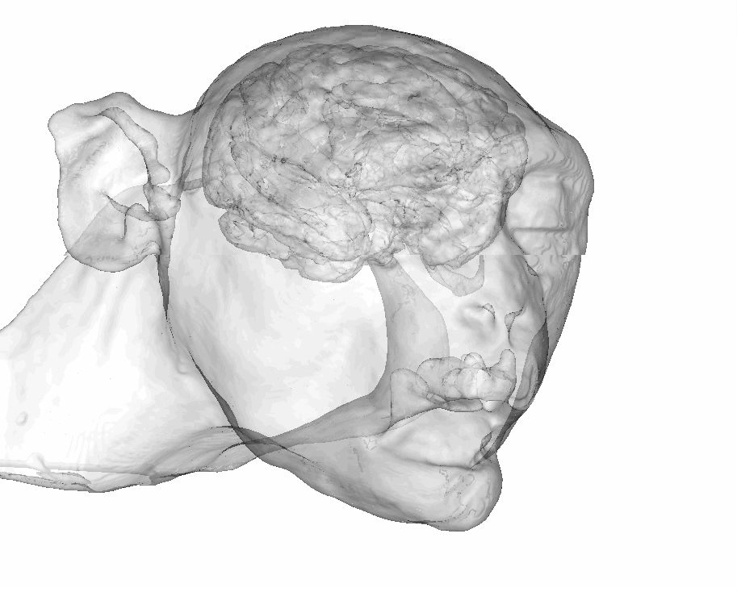
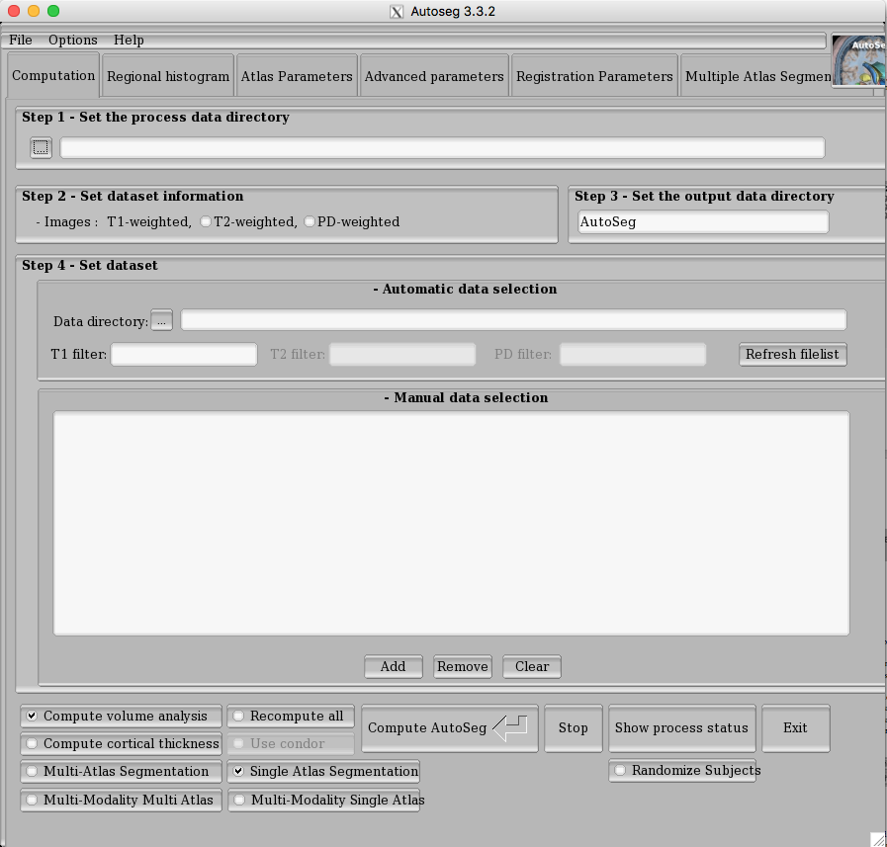
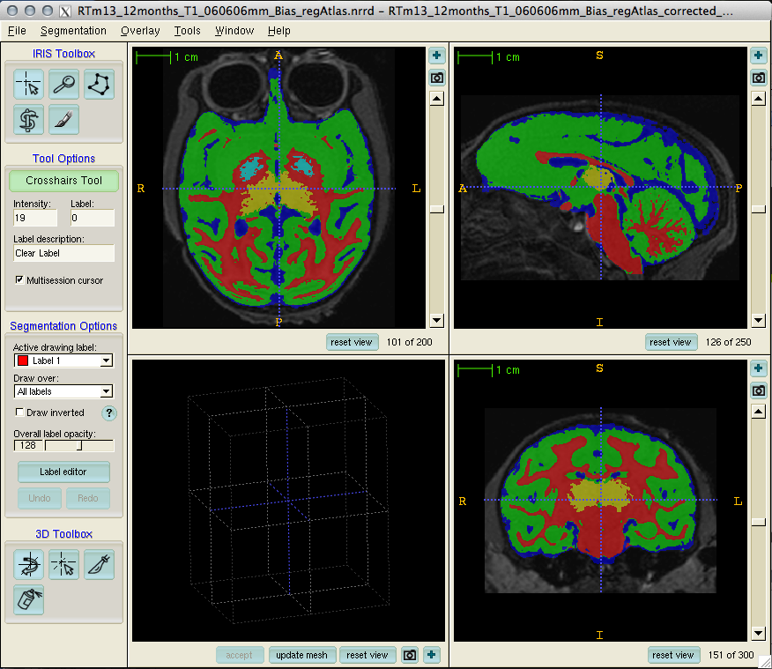
AutoSeg v3.3.2
Automatic Segmentation for Rhesus Monkeys MRI data
Authors: Britanny, Felicia & Martin

Slide 2
Intro Notes
Be sure the version of AutoSeg is the newest stable release
  Currently version 3.3.2, no major releases soon expected
  Future: In a few years, AutoSeg will be replaced
Be sure Slicer is installed
  AutoSeg uses several Slicer tools
Be sure ImageStat and ANTs is installed
  On the BITC, all tools are in /home/yundishi/UNC_Program/
First overview of processing, then example processing slides are for a single subject using the GUI
  Extends straighforwardly to multiple subjects

Slide 3
AutoSeg Processing Steps
Several steps optional
Tissue segmentation cannot be skipped currently
Foldernames
Initial Bias Correction
bias
Optional
Reference Space Alignment
atlasIso
Add Folders:
TissueSegAtlas
StrippedTissueSegAtlas
Tissue Segmentation (with bias correction)
ems
Not optional
Skull Stripping
Stripped
Add Folders:
warped-atlas-image
warped-atlas-labels
warped-atlas-parcellations
displacement_field
intensity_energy
harmonic_energy
Intenisty_energy
Single Atlas ROI & Parcellations
WarpROI
Multi Atlas ROI & Parcellations
fused-labels
Optional
Volume Computation
AutoSeg_Volume

Slide 4
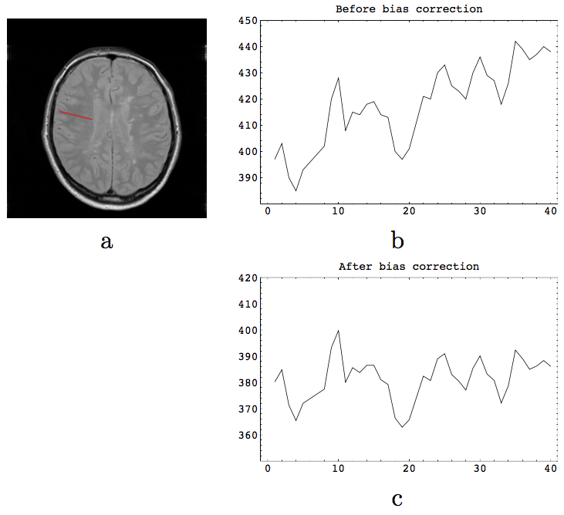
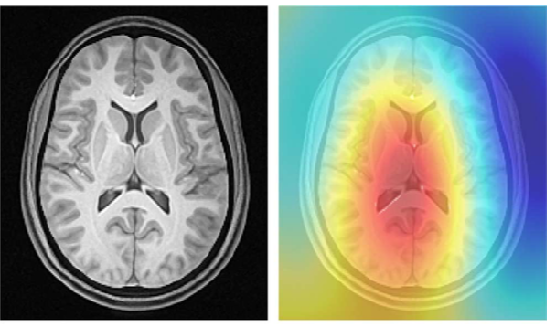
Bias Field Correction
Inhomogeneities in the MR magnetic fields
  Mainly receiver coil
  Results in a bias field
Same tissue has different intensities in different parts of the image
A preprocessing step is needed to correct for inhomogeneity in the image
AutoSeg uses N4, de-facto standard in field
Newer multi-channel coils need more sophisticated processing
Tustison et al. N4ITK: improved N3 bias correction. IEEE TMI. 2010;29(6):1310–1320.

Slide 5
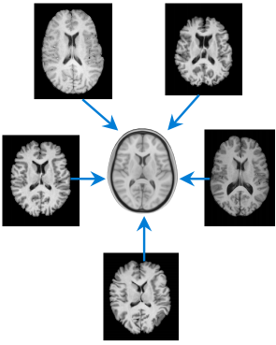
Registration into Reference Space
Rigid registration of the subject’s T1 into reference/atlas space
Rigid registration of the subject’s T2 into subject’s reference aligned T1 image
UNC-Wisconsin Atlas – 18 subjects, 16-34 months of age
UNC-Emory 2w, 3mo, 6mo, 12mo atlases
AutoSeg uses BRAINSFit for Rigid & Affine registration
Image from: http://fsl.fmrib.ox.ac.uk/fslcourse/lectures/reg.pdf

Slide 6
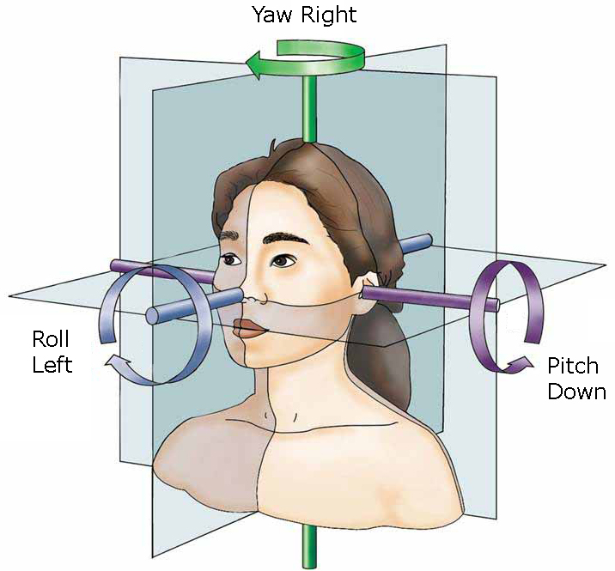
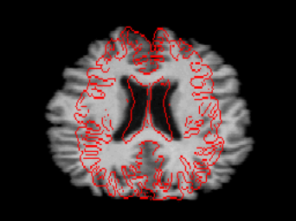
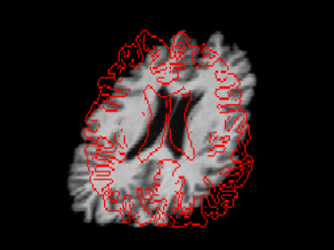
Registration into Atlas Space
Rigid Body Registration
6 degrees of freedom (DOF):
  3 rotations
  3 translations
Affine registration
12 DOF: 3 rotations, 3 translations, 3 scalings ,3 skews/shears
15 DOF: Full Affine Matrix
Image from: http://fsl.fmrib.ox.ac.uk/fslcourse/lectures/reg.pdf

Slide 7
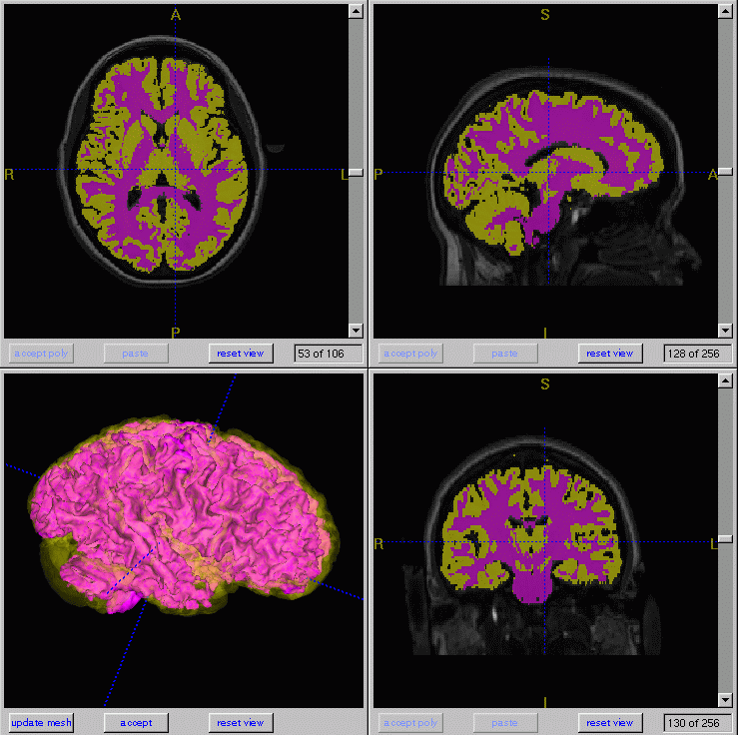
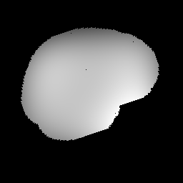
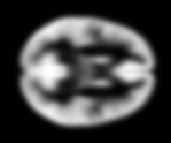
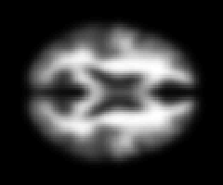
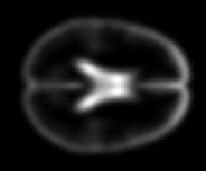
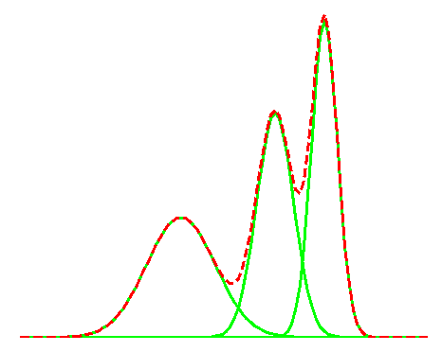
Atlas-Based Classification (ABC) Tissue Segmentation
Atlas Based Initialization
Step 1
Step 3
Bias estimation
Classification
Step 2
Distribution estimation
K. Van Leemput, D. Vandermeulen, F. Maes, P. Suetens, IEEE T. Medical Imaging, 10 (18), oct. 1999, Automated Model-Based Tissue Classification of MR Images of the Brain

Slide 8
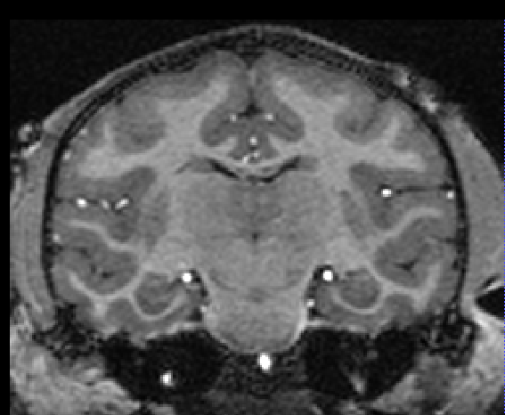
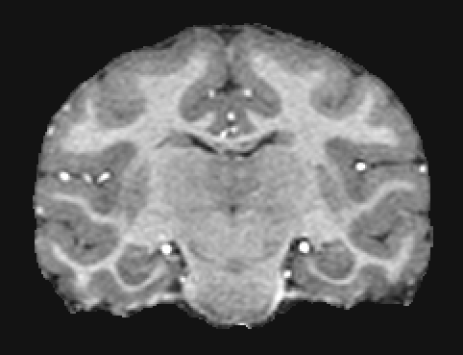
Skull Stripping
Use tissue segmentation for skull stripping
Often requires manual editing

Slide 9
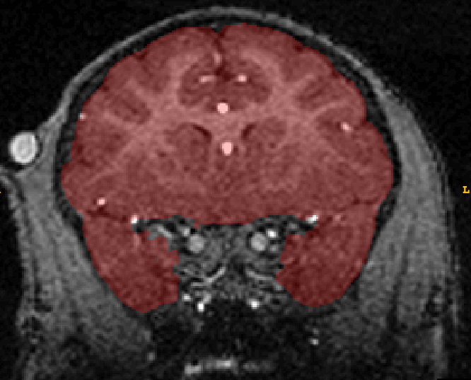
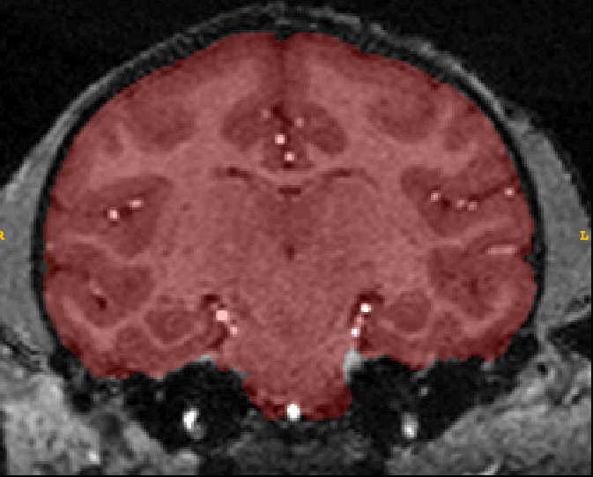
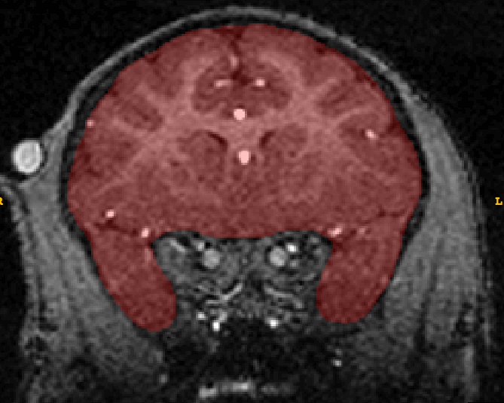
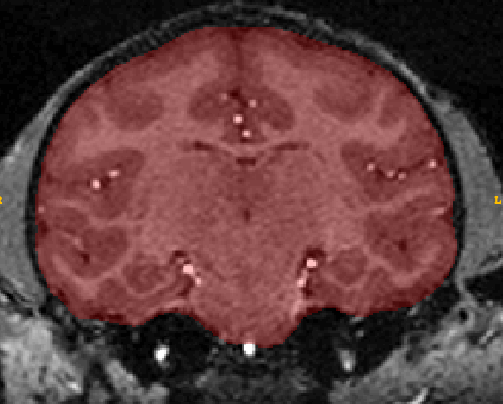
Notes:
Here are some images from one of the automatic skull-stripped masks generated by AutoSeg that I manually edited. I performed similar edits for each of the 300 coronal slices. In addition, some edits were easier to perform in the sagittal or transverse planes which are available in ITKSnap. I also used a smoothing tool in a program called Slicer that was able to smooth the edges. This was the most time consuming portion of my thesis, there were a 21 subjects and 2 scans for each subject for a total of 42 MRI scans so this was my primary focus last semester.

Slide 10
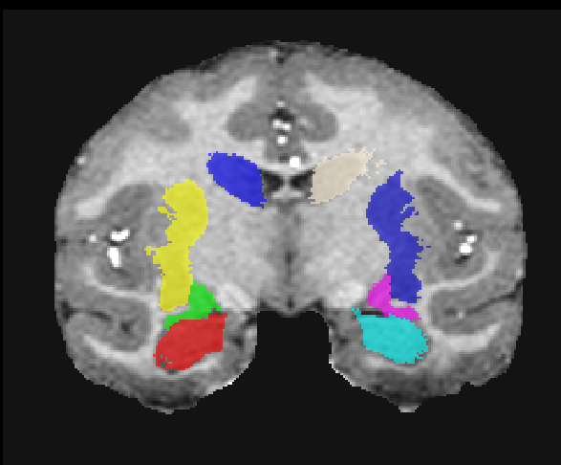
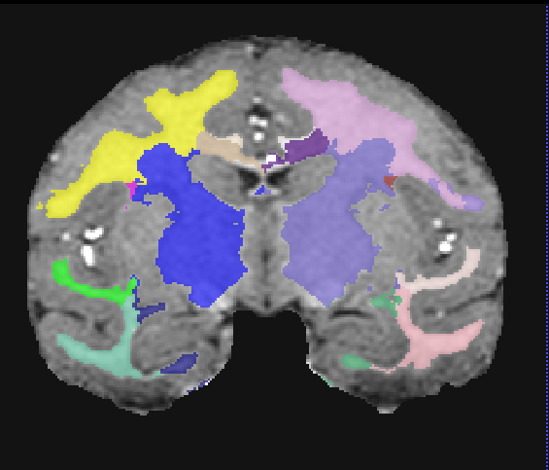
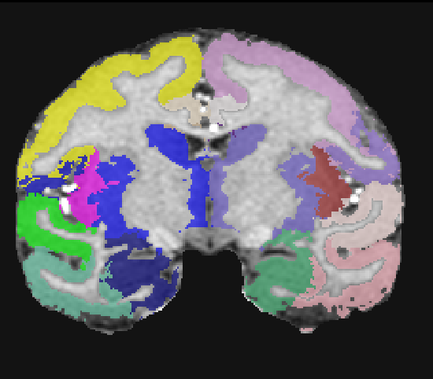
ROI & Parcellations
Single Atlas Segmentation
  Single atlas with information about ROI labels and parcellations
  Deformable registration (ANTS) to subject data, propagate labels & parcellations
  T1 only vs T1 & T2 registration, the latter is better, less error prone
Warps = deformation fields
Notes:
Next, a skull-stripped version of the atlas is then registered to the skull-stripped subject. Transformation matrices for each of the cortical and subcortical parcellations are generated during this registration step, and these transformations (or warps) are applied to each region in the atlas to get them into subject space and generate the subject’s parcellations. Examples of some of the parcellations generated at this step include regions such as the frontal, parietal, and occipital lobes and the cerebellum among others.
Warps = deformation fields = how much each voxel was transformed during the registration process
Applied to each lobar parcellation and ROI
NO ROIs – there are lobar (cortical) parcellations and subcortical parcellations
The segmentations are also blended with the cortical parcellations so that the WM, GM, and CSF of each cortical region can be calculated. This picture shows the GM and WM segmentations of each cortical region. For example, green corresponds to PFC, so the green in the left figure shows PFC GM and the green in the right PFC WM.

Slide 11
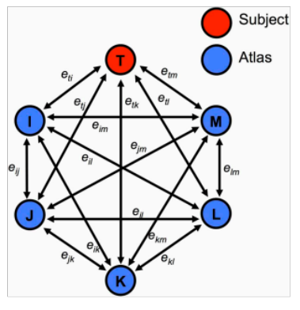
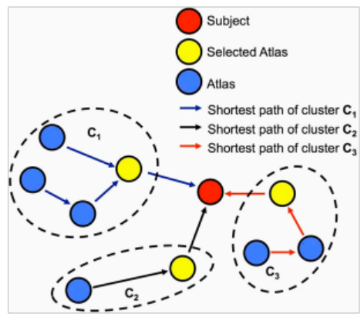
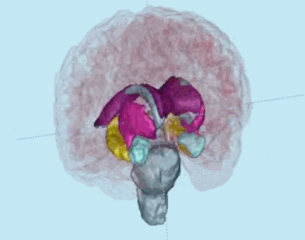
Multi-atlas Segmentation
Segment regions: Hippocampus, amygdala, caudate, putamen, GP, thalamus
Early brain development: Low SNR, small size => Partial volume
  Existing tools fail (FSL, FreeSurfer) (Morey et al 2009, Shoemaker 2016)
  Single atlases are just not good enough
Multi-atlas based segmentation (Jiahui Wang, Frontiers 2014)
  Atlas population of scans (incl. mirrored for symmetric processing)
  Multi-modality (T1w & T2w) registration, graph-based cluster selection
    Closest atlas for each cluster, Intensity match & deformation energy weighted

Slide 12
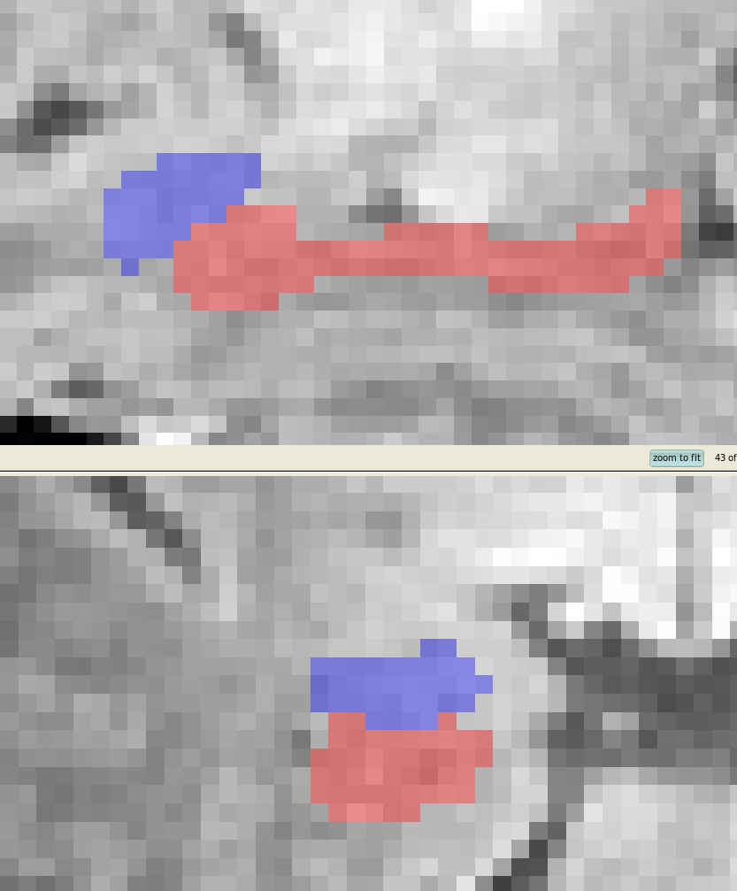
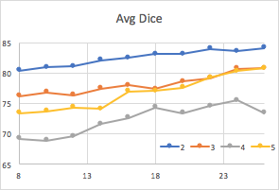
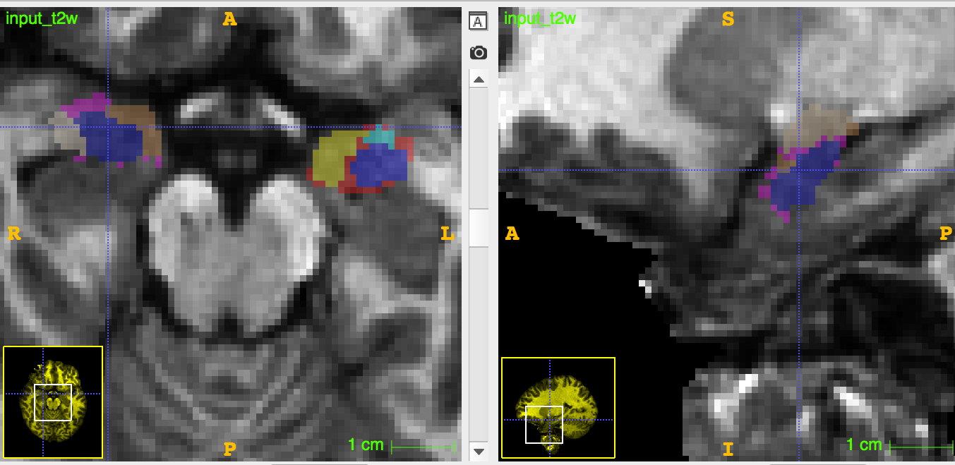
Example: Human MRI
Neonate: hippocampus + amygdala
  Atlas population of 8/16 scans
  Manual correction: 1.8% vol, 0.98 Dice, 0.1mm dist
  Reliability scan/rescan: COV < 0.4%
  Under review
1-2y: All subcortical structures
  IBIS studies
Adult: Amygdala sub-regions
  With U Wisconsin: Brendon Nacewicz
  14/28 atlases, edge enhanced images
  Not fully converged with 14 atlases
  Great performance: 0.75 – 0.85 Dice
  4 sub-regions (+1 other) per amygdala
  In prep

Slide 13
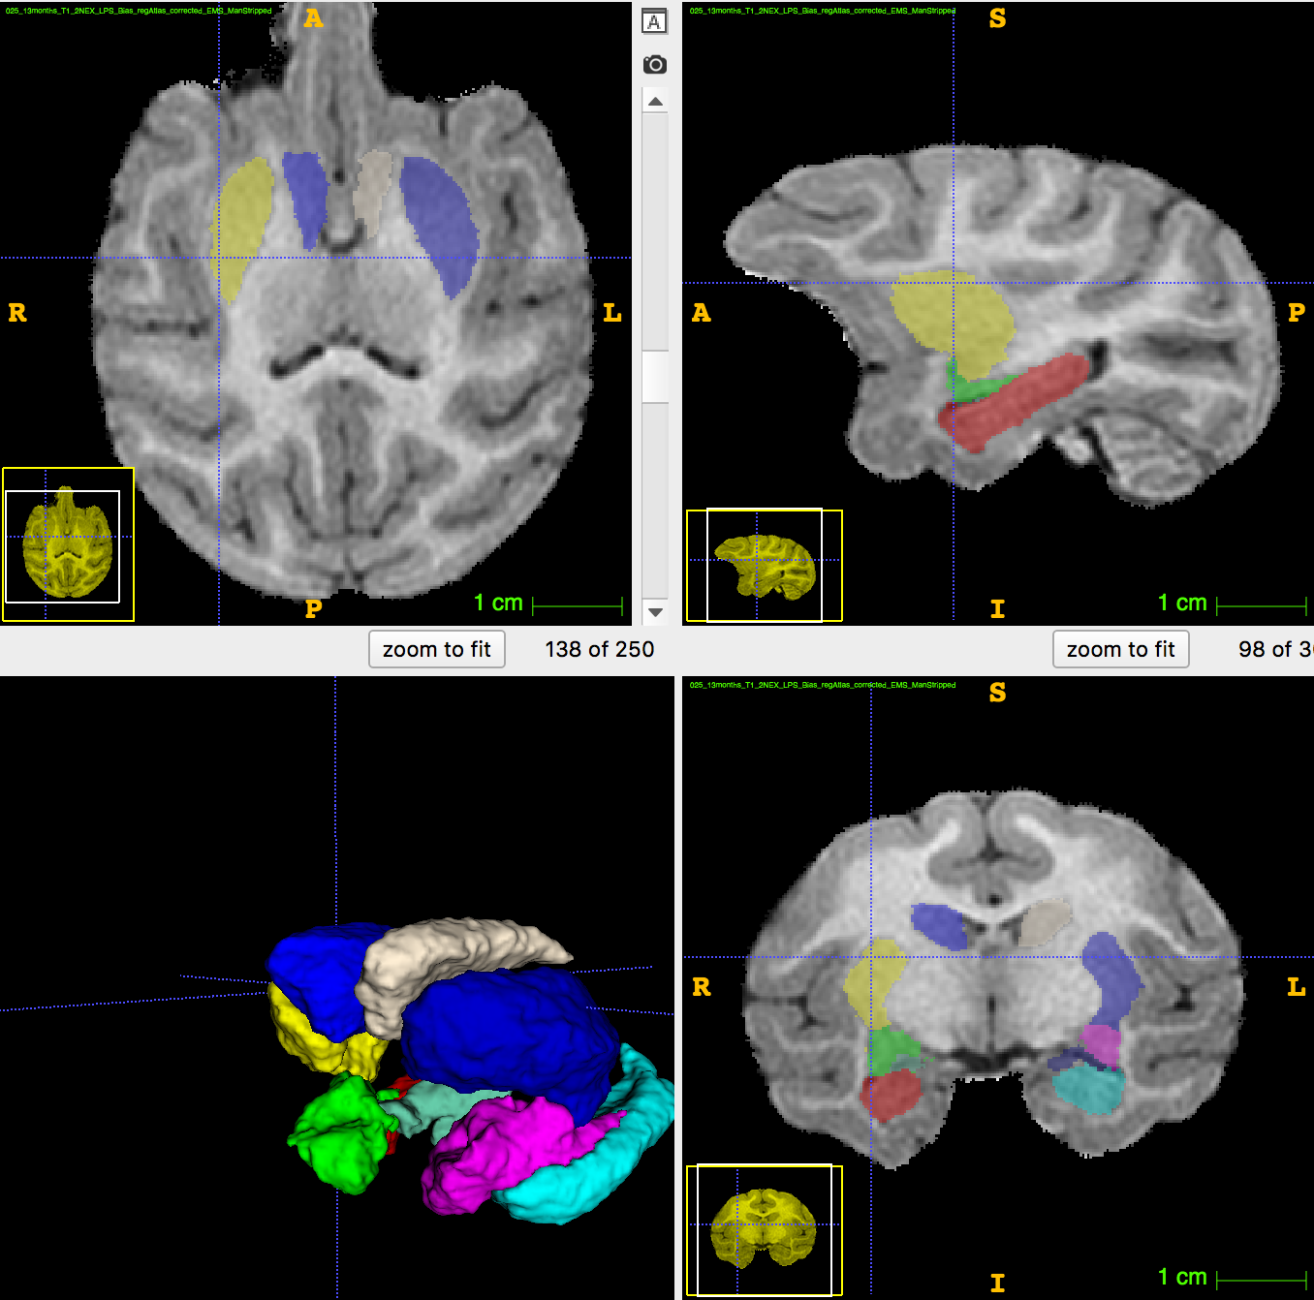
NHP Subcortical Multi-atlas
Amygdala subdivision
  With U Wisconsin: Brendon Nacewicz
  In development, soon
Major subcortical @ 12month
  Hippo, amygdala, putamen, caudate
  4/8 atlases (more needed)
  Thalamus & GP needed
Drawback: Very slow (we are working on it)

Slide 14
Data Preprocessing
Use a spreadsheet or other document to keep track of processing. It is important to maintain accurate records in case there are questions later.
Transfer all T1 and T2 DICOMs to a new working directory
Convert T1 and T2 DICOMs to NRRDs
  Helper script: DWIConvert_sMRI.script .../xiaodong^Anatomical_1/XXXX XXXX_T1.nrrd
Quality Control
  Look through all T1s and T2s using ITKSnap or Slicer to ensure the conversion worked and the images look good
  Cross check with scan notes

Slide 15
Initialization
Check image type
  Can use .gipl, .gipl.gz, .mhd, .hdr, .mha, .nhdr, .nrrd, nii, or nii.gz
  Use .nrrd or .nii.gz
Creates AutoSeg directory within your current working directory (specified in Step 3 of the Computation tab)
  It can be helpful to include the date in the name of this directory
Creates parameter (AutoSeg_Parameter.txt) and computation (AutoSeg_Computation.txt) files within AutoSeg directory

Slide 16
AutoSeg Start
AutoSeg –gui
  Needed to startup GUI
Set process directory
  Where logs & volumes are dropped
Set AutoSeg folder name
T1 vs T2 and T2

Slide 17
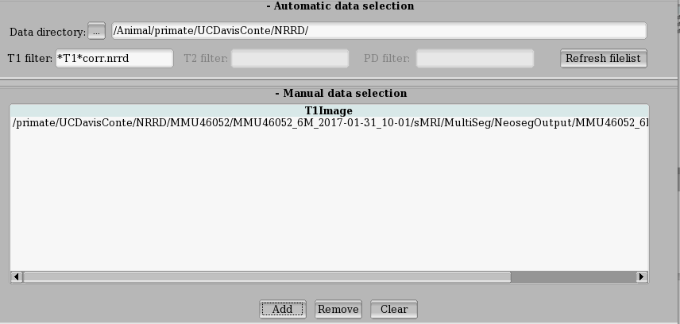
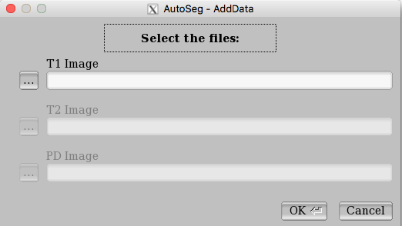
Data Selection
Select multiple dataset via automatic selection
  Set base folder
  Set suffixes for T1 and T2 images (* = wildcard)
Easier, but slower: select all dataset manually

Slide 18
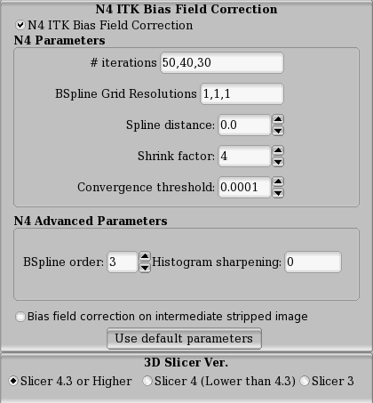
N4 Bias Field Correction
Set on the Advanced Parameters tab
Slicer’s N4
Use default parameters
Result in Bias folder
Disable if data is already bias corrected

Slide 19
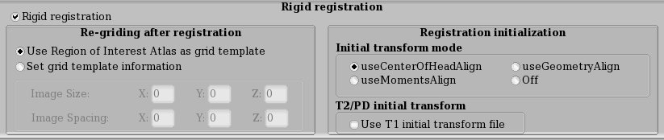
Registration to Reference Space
Registration Parameter Tab
Uses BRAINSFit to rigidly register subject’s T1 into atlas space, T2 to aligned T1
  Initialization: best useCenterOfHeadAlign
  Note that this means that all data produced are in atlas space, NOT native space (this can be important when trying to integrate AutoSeg outputs into other pipelines)
  Also note that this is done with skull

Slide 20
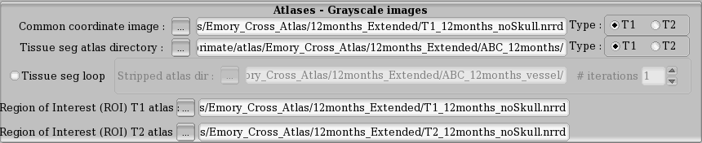
Registration to Reference Space
Results located in atlasIso
Reference image is the ”Common Coordinate Space”
  In Atlas Parameter Tab
  Can use both T1 and T2 atlases
  Gridding from ROI atlas => ROI atlas and Reference need to be in same space

Slide 21
ABC (Atlas-Based Classification)
This is the actual tissue segmentation program
First round is done with skull (results in ems folder), second round is done after skull-stripping (results in ems_2 folder)
An additional ems_# folder is produced for each additional loop
Note, this method affinely registers and then warps the atlas to the individual, not the other way around

Slide 22
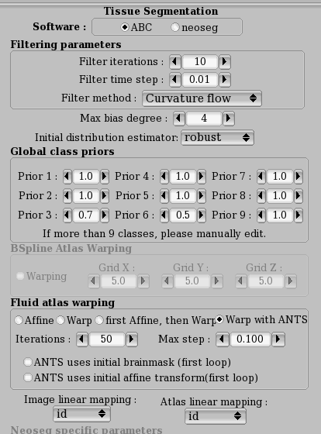
ABC (Atlas-Based Classification)
Advanced Parameter Tab
  Always use ABC
  Filter defaults fine
  Class priors can be adapted for a new study to change relative weights
  Atlas warping use “Warp with ANTS”
    With skull: use first loop options
    Stripped: disable first loop options
    Make sure mappings are set to id
      This tells ABC not to do its own registration

Slide 23
Skull-stripping
Uses tissue segmentation to identify brain vs. non-brain
Not perfect, typically needs to be manually edited
ITKSnap is good for the manual edits

Slide 24
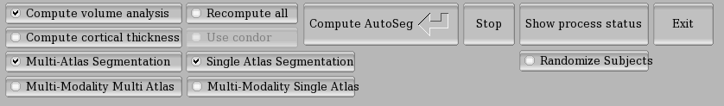
ROI Segmentation
Computation tab
Select your atlases and modes
  Single vs multi-atlas segmentation?
  Only T1 or T2 & T2 (Multi-modality)?

Slide 25
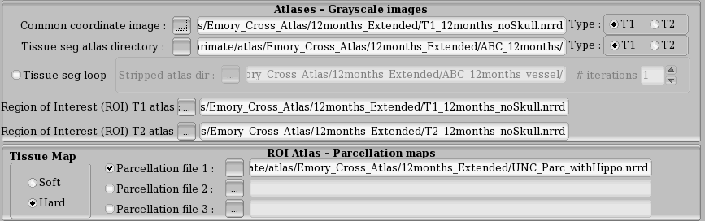
Single Atlas Segmentation
Single atlas: atlas parameter tab
  Select ROI atlas
    Both T1 and T2 needed for multi-modality
  Use Hard for Tissue map setting for Parcellation
  Select your generic ROI maps

Slide 26
Multi Atlas Segmentation
Multiple Atlas Segmentation
  Use defaults
  Set Multi-Atlas Directory
  Terminal: ”Multiatlas numbers: # T1, # T2 , #label, #parc”
    When setting, double check for correct info in terminal

Slide 27
Go!
Click “Compute AutoSeg”
  Window with log open
  You can close that window and computation continues
    Use “Show process status” to bring it up again
  You can close AutoSeg => Press Exit. AutoSeg will ask whether computation should continue in background or should be stopped
Want to stop? Press Stop

Slide 28
Using Manually Edited Masks
2 Approaches:
  A) Hack AutoSeg folder:
    Remove stuff that you want recomputed
    Replace mask in appropriate ems folder
    Rerun AutoSeg
    AutoSeg only computes files that are missing, unless ”Recompute All” is enables
  B) Better: Rerun AutoSeg using stripped T1 and T2
    Apply skull stripping manually and start new AutoSeg from those images
    Differences to initial run:
      Disable Bias correction,
      Disable Rigid registration,
      One segmentation loop
      Use skull stripped atlas,
      Disable first loop options for ABC

Slide 29
Volume Computation
Creates and populates AutoSeg_Volume folder, which is created in the process directory
Volumes are gathered from the .csv files within the last ems folder created (tissue volumes), the WarpROI folder (lobar parcellations – a value for each tissue class - and whatever other ROIs were used) and the fused_label folder (multi-atlas labels)
Remove those csv files when recomputing AutoSeg to ensure updated results

Slide 30
Rerunning the Analysis
If you need to rerun the analysis you will need to:
  Append the .bms files in the process directory to reflect the date run (this will allow new .bms files to be produced while maintaining a record of what was done)
  Similarly, append the parameter and computation files in the individual case directory
  Delete/append files/directories that you want to replace
    You could also check the “Recompute All” button on the Computation tab, but this will repeat all steps. Most of the time the registration steps won’t need to be repeated.

Slide 31
Additional Notes/Considerations
Keep good notes of what you did
  Spreadsheet that includes the full paths to all files, case IDs, parameters used, etc.
  Word document with scripts copied and pasted, and all troubleshooting
Append as opposed to deleting
  Better to have a superfluous copy of something than to delete something useful
  Balance this with space needs
README.txt files are your friends
  Use gedit to create a simple text file that explains what was done and why
  This is especially useful if there are dummy files anywhere or if there is anything that might be confusing to someone looking at the results somewhere down the road
Update the protocols as you go (this includes troubleshooting issues)
  Things change, so when they do, write it down!
  Go through everything step by step to identify where something went wrong
    Check to make sure the expected inputs were where they should have been
    Also check the error log

