Slide 1
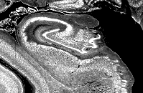
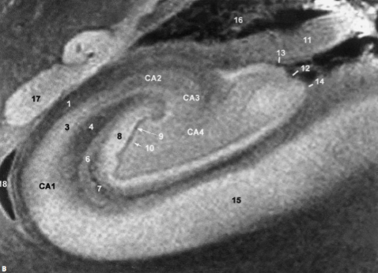
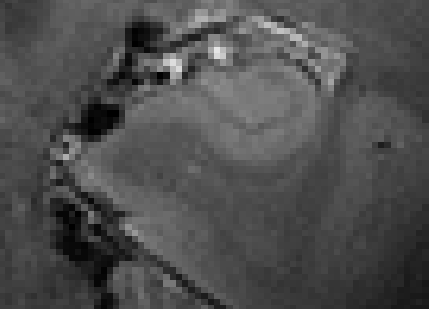

Harmonized Protocol for Subfield Segmentation in Hippocampal Body
on behalf of the
Hippocampal Subfield Group
Toronto Training
April 11-12, 2024

Slide 2
Training Workshop Leadership
Lead: Ana M. Daugherty, Ph.D., Wayne State University
Toronto Site Lead: Rosanna Olsen, Ph.D., Baycrest Institute
Reliable Raters/Trainers:
  Thackery Brown, Ph.D., Georgia Institute of Technology
  Kelsey Canada, Ph.D., Wayne State University
  Gustaf Rådman, Lund University

Slide 3
No financial conflicts of interest to disclose.
The HSG work is supported by NIH/NIA R01 AG070592, and formerly Joint Programme—Neurodegenerative Disease Research.
MRI data shared by investigators were collected with support from NIH/NIA R01 AG011230, NIH/NICHD R01 HD079518, NIH/NIMHD R01 MH107512, NIH/NIA R01 AG056535.
Daugherty is additionally supported by NIH/NIA P30-AG072931; Canada by NIH/NICHD F32-HD108960; Brown by NIH/NIA R01 AG073250 and The Shurl and Kay Curci Foundation

Slide 4
For This Training You Will Need
Laptop with ITK-Snap Installed
  Segmentation can be implement with a mouse or peripheral tracing tablet
Digital Reference Materials + Example MRI Scans
Additional Materials for After the Training:
  YouTube Videos
  Detailed Method Supplement with Histological Reference Material
  Website Updates

Slide 5
Purpose of Protocol Training
Harmonization
  Facilitate wide adoption of the protocol
  Provide information to implement the protocol for new investigators
Reliable implementation
  Training resources for protocol consistency across labs
Learning Objectives:
  Review hippocampal anatomical landmarks relevant for subfield labeling on high-resolution T2-weighted MRI
  Practice the manual segmentation protocol for hippocampal subfields in the body
  Identify resources for continued protocol updates and self-guided training

Slide 6
Timeline for Training
Here you will have an introduction to the protocol and practice with opportunity for feedback
You Can Expect to Walk Away With:
  An introductory knowledge of hippocampal anatomy
  Hands-on experience with the manual segmentation protocol on example MRI scans
  Online resources to support continued training and practice
Typical timeline for implementation: 1-4 months to establish reliability on your own data (depends on the number of raters, quality of data)

Slide 7
Hippocampal Subfield Group

Slide 8
The Medial Temporal Lobe (MTL)
Human post-mortem and animal model data suggest that hippocampal subfields:
  Are differentially affected by age (development, aging)
  Are differentially affected by disease (e.g, inflammation, AD, TLE)
  Are sensitive to interventions (e.g., aerobic exercise)
These differences have generated increasing interest in measuring subfield structure and function in vivo
From PubMed: Number of publications involving MRI and hippocampal subfields, 2000-present
Notes:
However, the MTL is not a unitary structure, rather, it’s composed of…
--
Our initial efforts have focused on hippocampal subfields, but as I’ll mentioned towards the end of my talk, we are currently applying for funding to begin focusing on MTL cortical regions

Slide 9
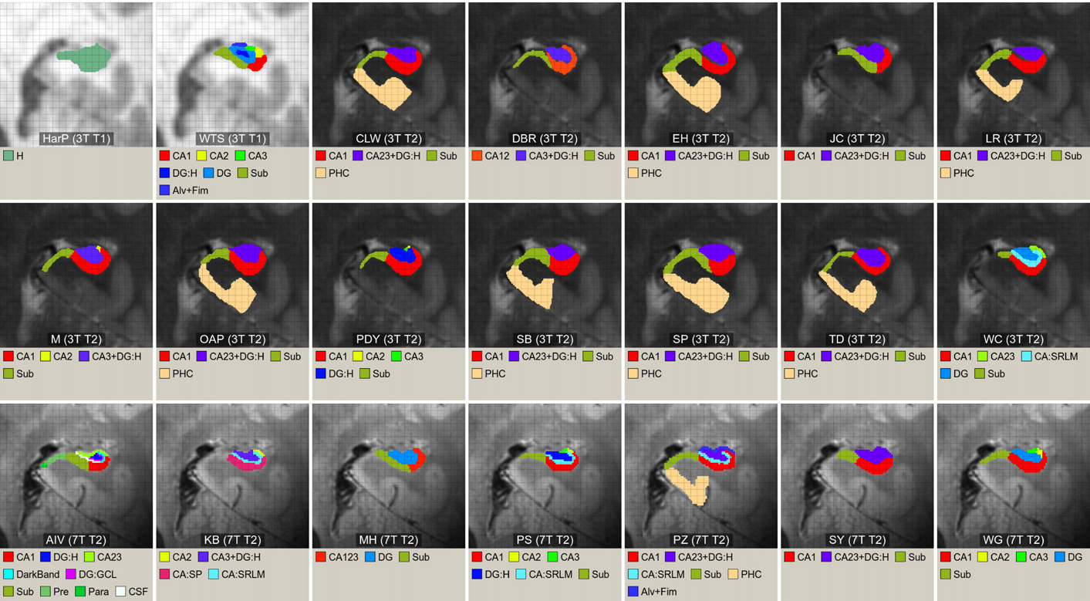
Existing Protocols Meaningfully Differ
Comparison of 21 protocols in a coronal slice of the hippocampal body
Yushkevich et al., 2015 NeuroImage
Notes:
Too much time here – simply point out differences in sub/ca1

Slide 10
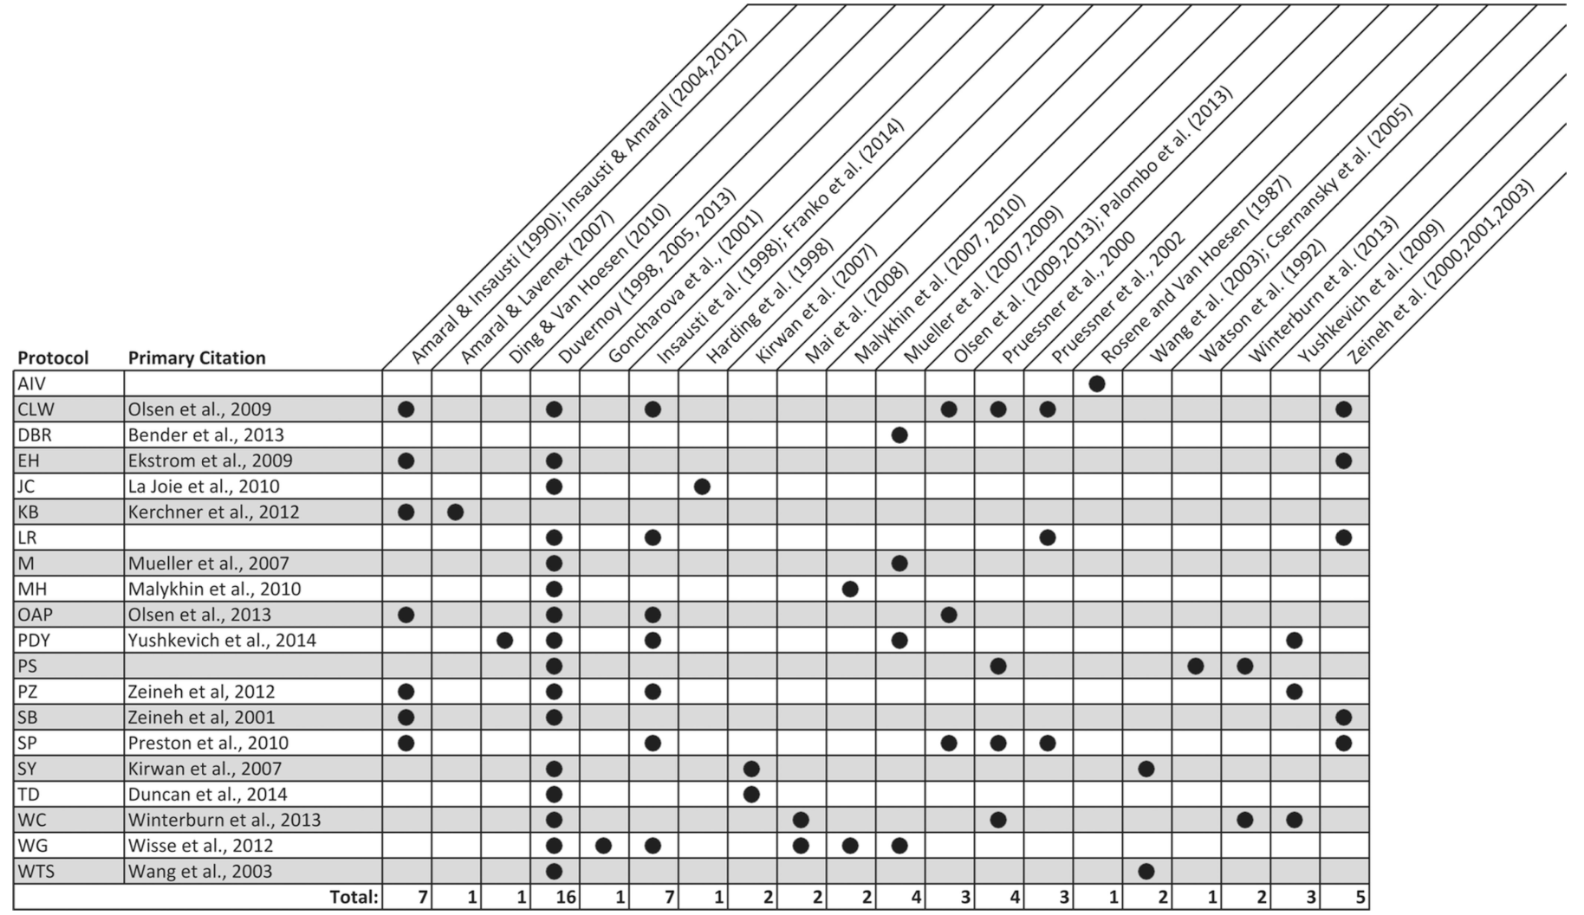
Differences in Histological & Anatomical Reference
Yushkevich et al., 2015 NeuroImage

Slide 11

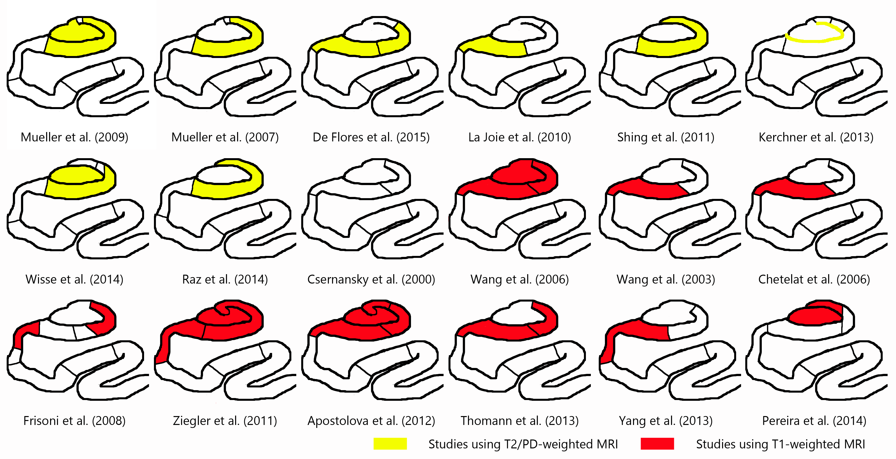
Challenge to Compare Results
Courtesy of Laura Wisse
Comparison of results across studies of the relation between adult age and subfield volume
Sub
CA1
Notes:
colored regions are reported to be significantly associated with aging; border locations are our best approximation of each of these protocols

Slide 12
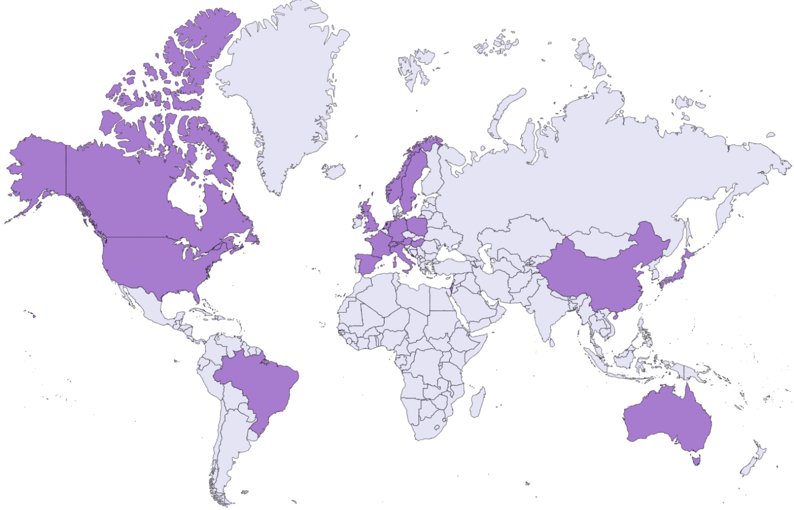

Work of the
Hippocampal Subfields Group (HSG)
  Open to all, new members welcome!
International group of researchers to collaboratively develop a harmonized protocol for segmenting subfields on MRI
  Validated, reliable, and applicable to populations of variable age and health
Want to Join?
Learn More Here
  Find us on our website, Twitter, and YouTube

Slide 13
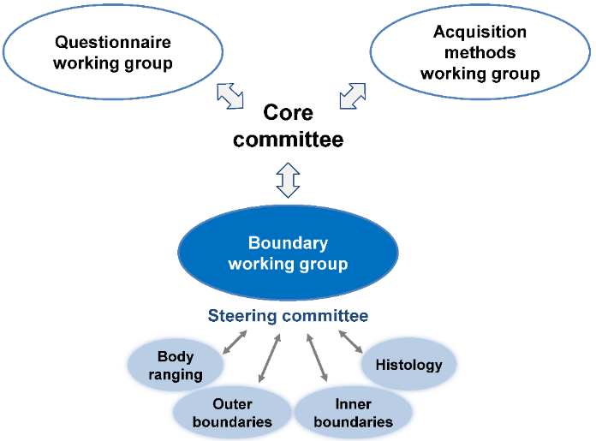
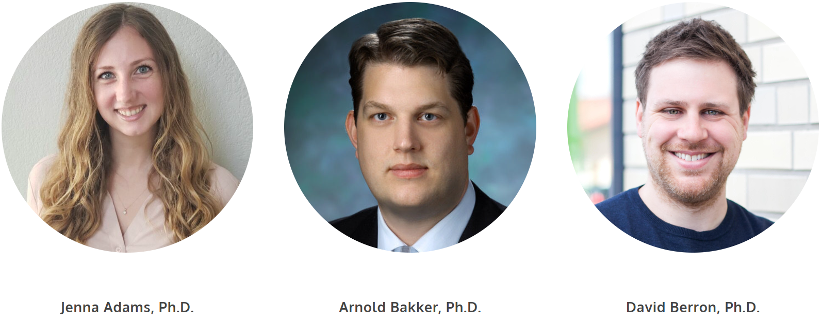
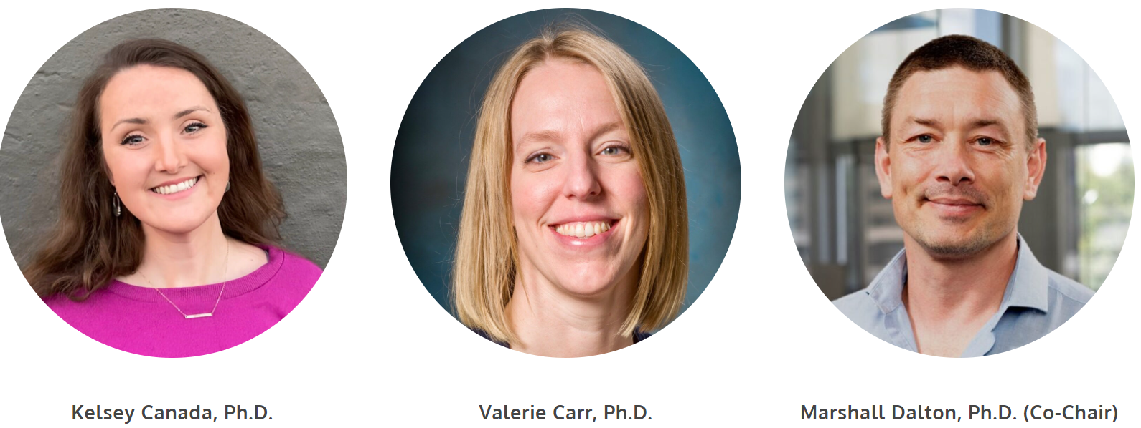
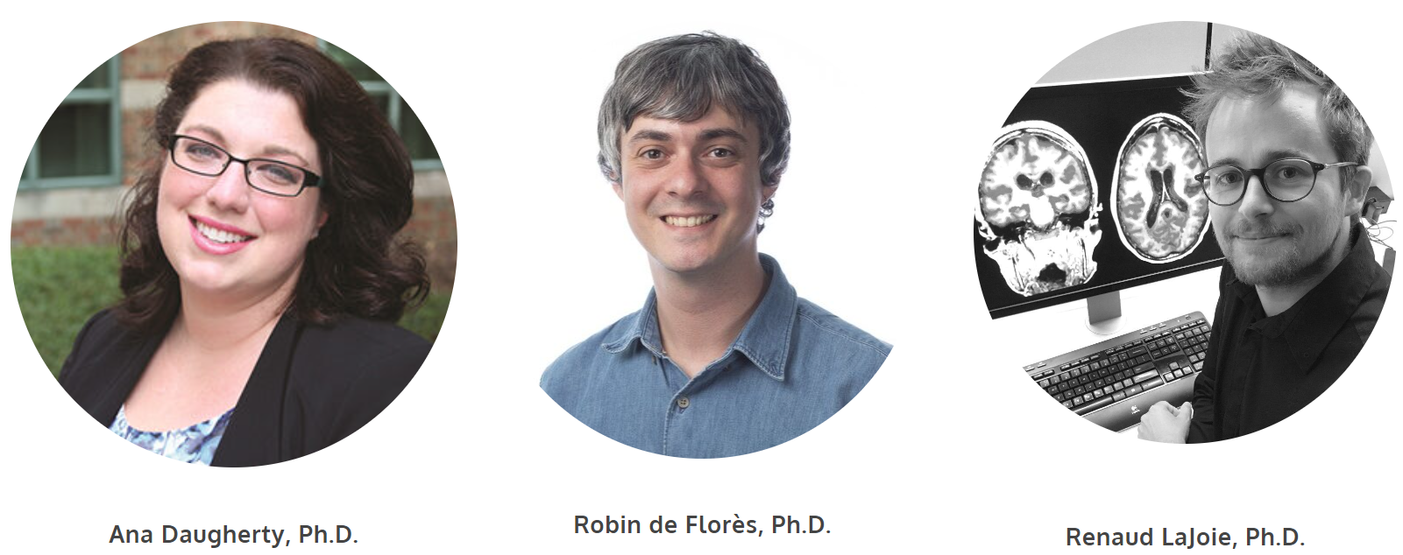
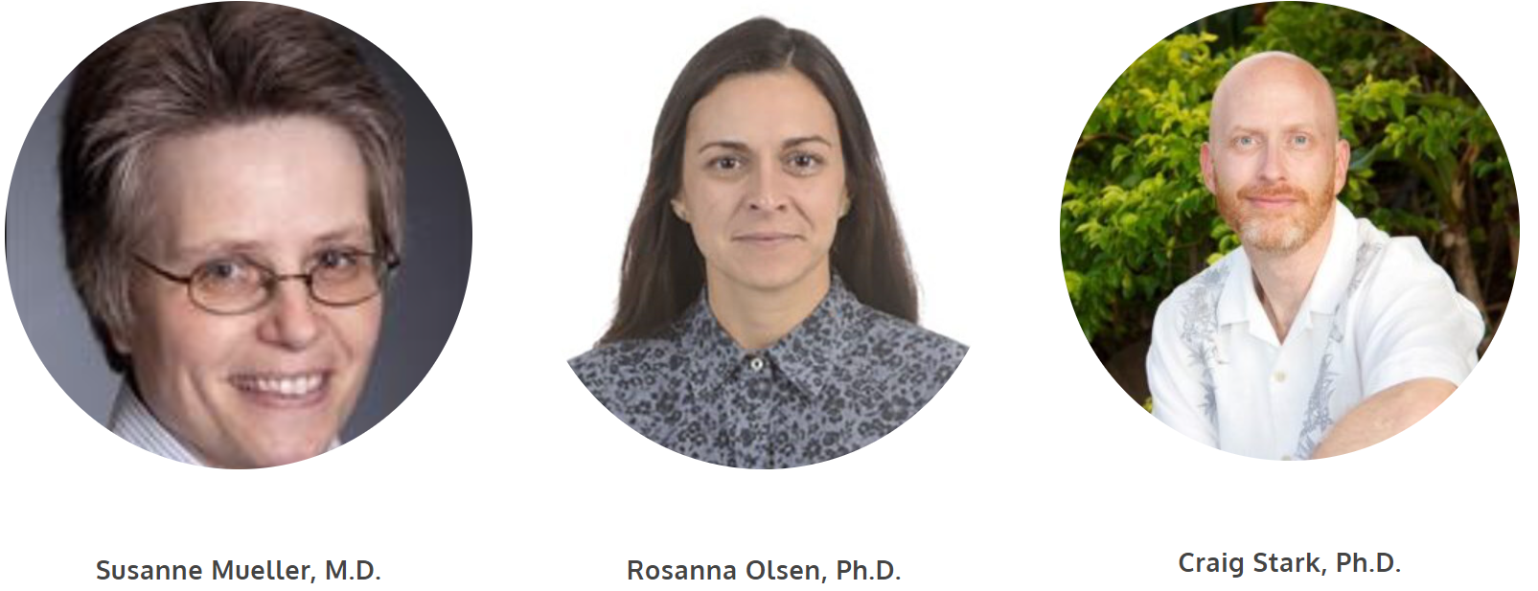
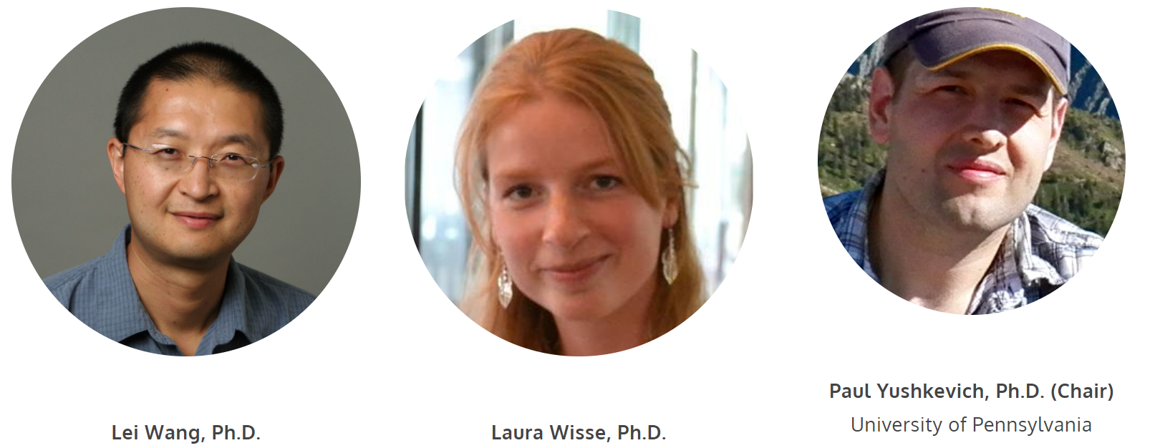
HSG Structure
Communication
Kelsey Canada
Hannah Baumeister
Gustaf Rådman
HSG Advisory Committee
Valerie Carr
Paul Yushkevich
Daniela Palombo Laura Wisse
Karen LaRocque
Alison Burggren
Mirjam Geerlings
Advisory Committee
Craig Stark
Arne Ekstrom
Mallar Chakravarty Marie Chupin
Zach Reagh
Jenna Adams
Tammy Tran
Hannah Baumeister
Negar Mazloum-Farzaghi
Thanh Doan
Anika Wuestefeld
Anne Maass
MTL
Head
Tail
Robin de Flores
Nicole Gervais
Anne Maass
Jonathan Shine
Marshall Dalton
Robin de Flores
Trevor Steve
Renaud La Joie
Ana Daugherty
Daniela Palombo
Attila Keresztes
Robin de Florès
Joshua Lee
Lorenzo Pasquini
Elliott Johnson
Elizabeth Mulligan
Meg Schlichting
Yushan Huang
Body outer borders
Body inner borders
Laura Wisse
Ricardo Insausti
Jean Augustinack
Katrin Amunts
Olga Kedo
Song-Lin Ding
David Berron
Robert Amaral
Prabesh Kanel
John Pluta
Trevor Steve
Renaud La Joie
Ana Daugherty
David Berron
Valerie Carr
Robin de Flores
Nikolai Malykhin
Rosanna Olsen

Slide 14
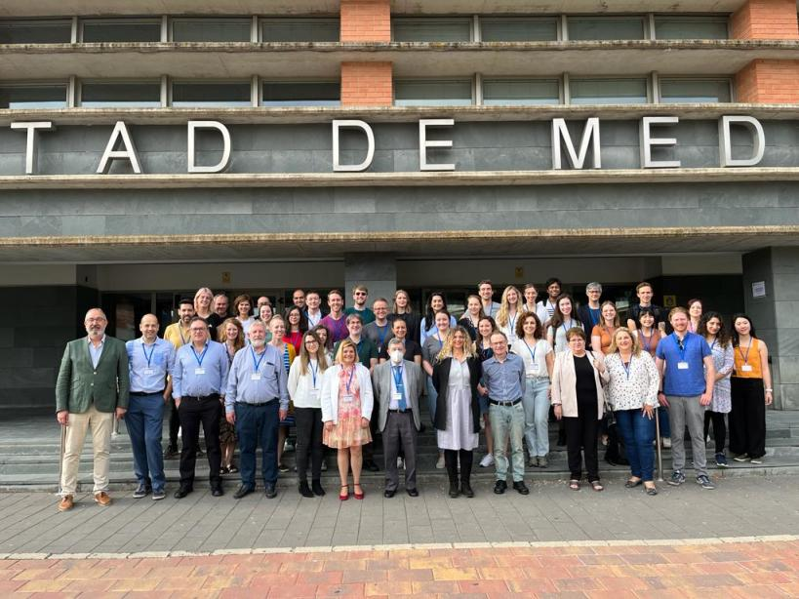
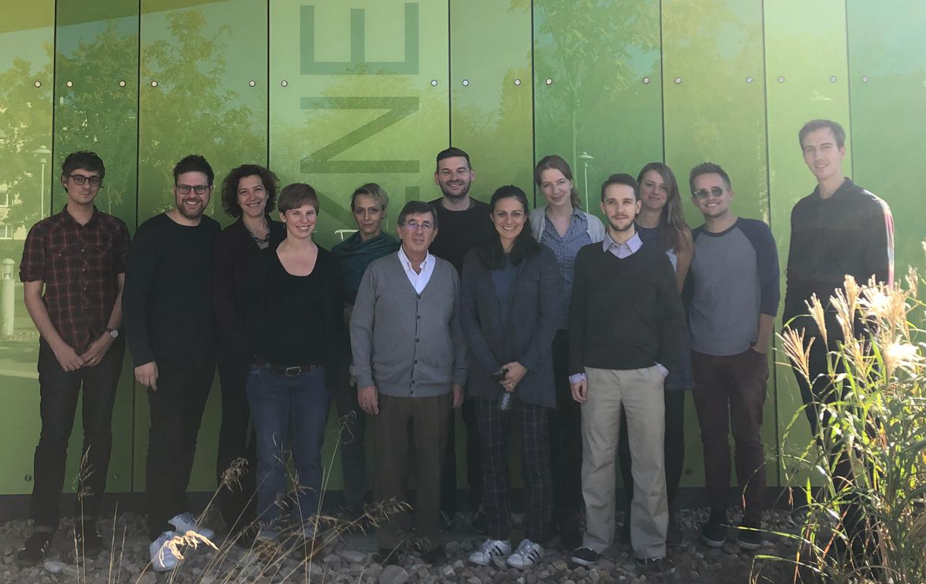


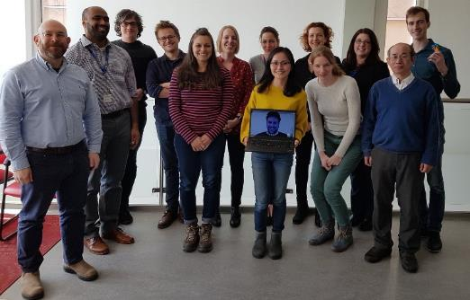
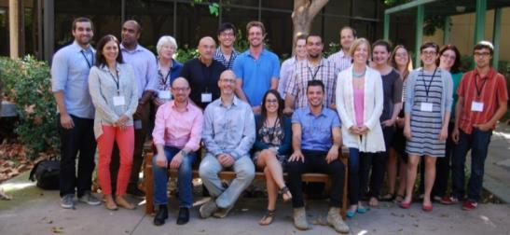
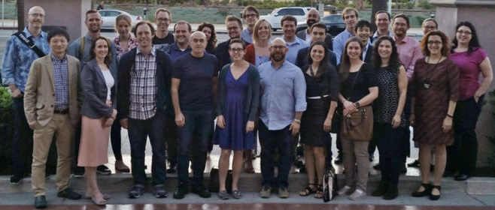

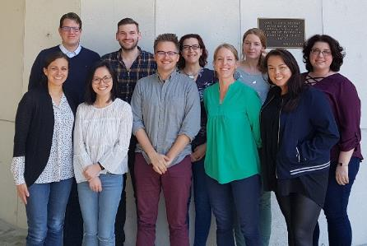
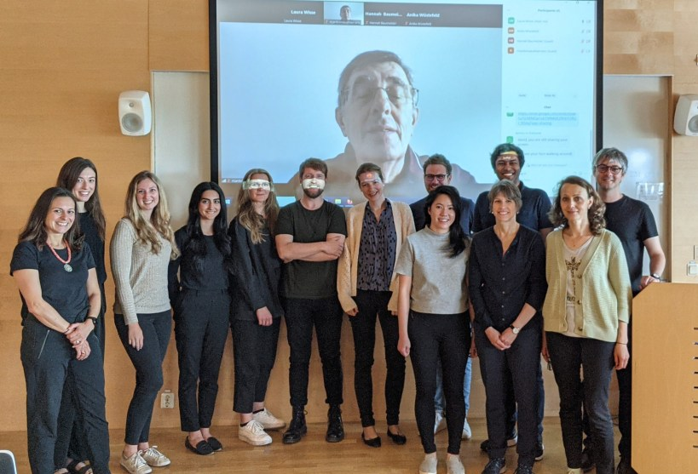
HSG Meetings
San Diego
Nov 2018
Albacete
Jun 2023
San Diego
Nov 2022
OvGU Magdeburg
Oct 2018
UC Davis
June 2013
Chicago
Nov 2015
Montreal
April 2017
Webinar series
Feb – June 2021
Lund
Oct 2023
Washington DC
Nov 2017
2013 2014 2015 2016 2017 2018 2019 2020 2021 2022 2023
Baltimore
Nov 2023
San Diego
Nov 2013
UC Irvine
Aug 2014
San Diego
Nov 2016
London
July 2017
UC Irvine
April 2018
Lund
June 2022

Slide 15
Publications
Yushkevich, P.A., et al., for the Hippocampal Subfield Group (HSG) (2015). Quantitative comparison of 21 protocols for labeling hippocampal subfields and parahippocampal cortical subregions in in vivo MRI: initial steps towards a harmonized segmentation protocol. Neuroimage 111:526-41.
Wisse, L.E.M. & Daugherty A. et al., for the Hippocampal Subfield Group (HSG) (2017) A harmonized segmentation protocol for hippocampal and parahippocampal subregions: why do we need one and what are the key goals? Hippocampus. 27(1)3-11.
Olsen, R. K., et al., (2019). Progress Update from the Hippocampal Subfields Group. Alzheimer's & Dementia: Diagnosis, Assessment & Disease Monitoring, 11, 439-449.
Wuestefeld, A. & Baumeister, H., et al. (2024). Comparison of histological delineations of medial temporal lobe cortices by four independent neuroanatomy laboratories. Hippocampus, 1–20.
Canada KL* & Mazolum-Farzaghi N*, et al. , on behalf of the Hippocampal Subfields Group. A (Sub)field guide to quality control in hippocampal subfield segmentation on high-resolution T₂-weighted MRI. Under review.

Slide 16
Methods for Protocol Development
Protocol Consensus and Reliability

Slide 17
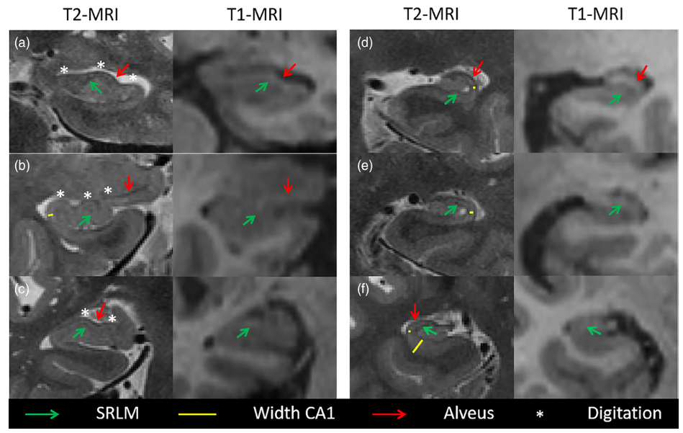
Protocol Developed for Common Scan Type
Resolution: high in-plane (typical 0.4 x 0.4 mm)
  The size of the subfields and landmarks are small
Weighting: T2 (FSE or TSE)
  Visualization of the SRLM is important for accuracy
Alignment: Perpendicular to long-axis of the hippocampus
  Some protocols will manually re-align each hemisphere with isotropic scans in post-processing
Acquisition: Coronal, Length of the hippocampus
  The subfields are visualized in the coronal plane and morphometry changes anterior-posterior
For examples and suggested parameters: http://www.hippocampalsubfields.com/people/acquisition-working-group/
Wisse et al., 2022 HBM

Slide 18

Protocol Development Process
Body
Step 1: Collect labeled histology
Step 2: Develop rules for subfield boundaries on high-resolution MRI
Outer boundaries
Inner boundaries
Step 3: Initial feasibility check
Step 4: Collect feedback from HSG
Delphi Procedure
Step 5: Formal reliability analysis

Slide 19
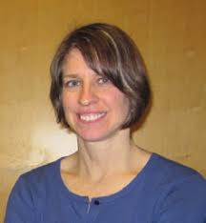

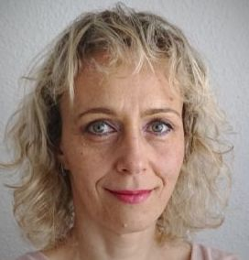
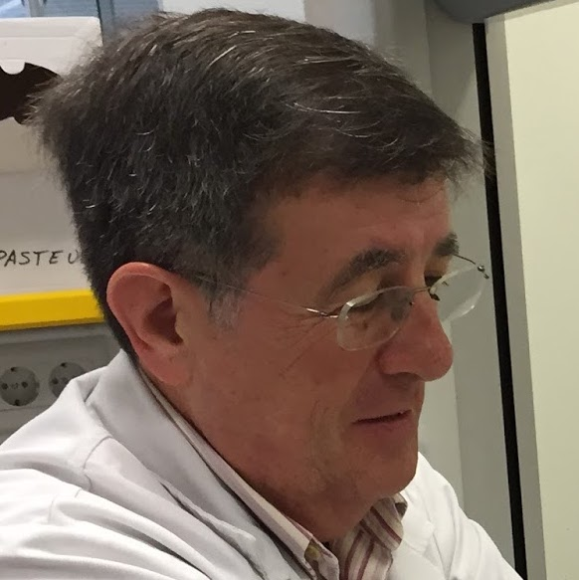
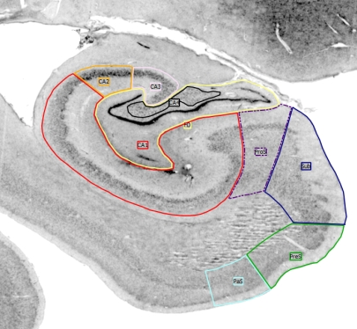
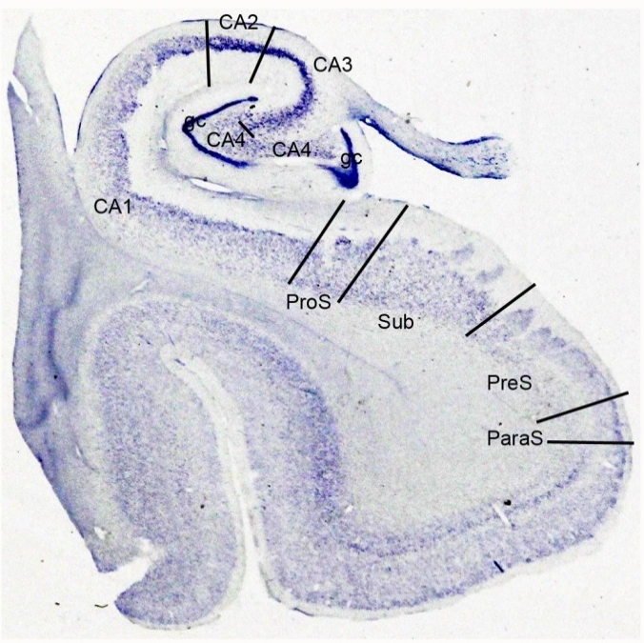
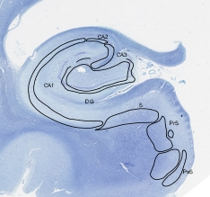
Step 1: Collect labeled histology
Representing between-person differences in anatomy, anterior-posterior variability,
and differences in histology methods
Augustinack
Ding
The histology dataset includes 3 samples (6 slices each) of the hippocampal body
All samples were segmented by at least three neuroanatomists
Additional reference materials from published sources
See Supplement for detailed images and comparisons to harmonized protocol
Kedo
Insausti
Annotated histology sections of hippocampal body (left: silver stain, annotated by Drs. Amunts & Kedo; middle: Nissl stain, annotated by Dr. Augustinack; right: Kluver-Barrera method, annotated by Dr. Insausti)
Notes:
Samples range from 6-16 slices; thickness ranges from 0.8mm – 2mm
--
Slices are oblique coronal, matching typical high-res MRI protocols

Slide 20
Step 2: Develop segmentation protocol
Guided by this labeled histology, we developed a draft protocol for the inner boundaries of the hippocampal body
Uses MRI image contrast, anatomical landmarks, and geometric heuristics
Developed subfield boundaries between:
  Subiculum-CA1
  CA1-CA2
  CA2-CA3
  CA3-DG
Evaluated two options:
Geometric (simpler, more reliable, less valid)
Endfolial (complex, less reliable, more valid)
Notes:
Thanks to the inner subfields boundary working group, and Ana Daugherty and her team members especially

Slide 21
Step 3: Initial feasibility check
Two experienced raters; naïve to protocol prior to training
Segmented 6 brains (varying age, disease, image quality)
Assessed inter-rater reliability for all subfields
Subfield (protocol) | ICC(2) | Dice
Sub | 0.45 | 0.76 + 0.07
CA1 | 0.94 | 0.83 + 0.06
CA2 | 0.83 | 0.61 + 0.10
CA3 (geometric) | 0.84 | 0.69 + 0.07
CA3 (endfolial) | 0.56 | 0.62 + 0.08
DG (geometric) | 0.99 | 0.79 + 0.06
DG (endfolial) | 0.97 | 0.80 + 0.04
Notes:
Training included detailed documentation with example image tracings, a 2-hour introductory training session (via Skype), followed by prescribed practice and then an additional 1-3 hours of individualized feedback (via Skype).
--
Dice = overlap in voxels
ICC = consistency in volume measurements

Slide 22
Step 4: Feedback from HSG members
Questionnaire released in December 2021 that included:
  Written descriptions, histology, MRI
  Initial feasibility results
  Links to supplemental documentation, data sets, and training videos
Questionnaire asked about:
  Clarity of each subfield boundary
  Level of agreement with each boundary
  Preference for CA3-DG geometric or endfolial rule
  Suggested revisions to each boundary

Slide 23

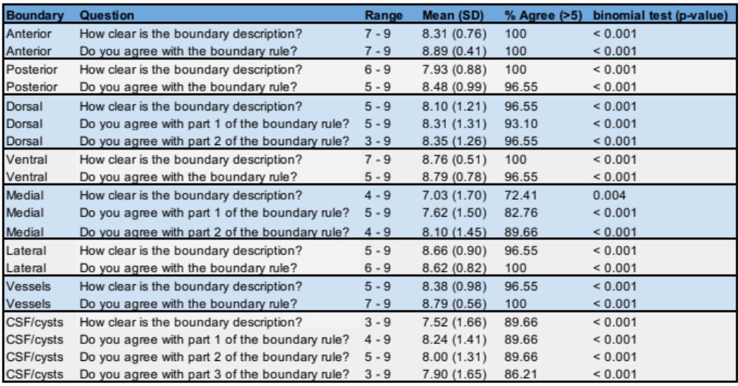
Step 4: Delphi Procedure for Consensus
Courtesy of
Dr. Valerie Carr
Body Outer Boundaries
N = 29 laboratories participated; 72.4% of labs indicated 5+ years of experience with manual subfield segmentation
All outer boundary definitions had agreement (>5 on scale 1-9) and we queried opinions of description clarity
Notes:
CA3-DG geo was a bit binary, with some people clearly opposed; nonetheless, the majority preferred the geometric rule about 2:1
CA3-DG end: 77%

Slide 24
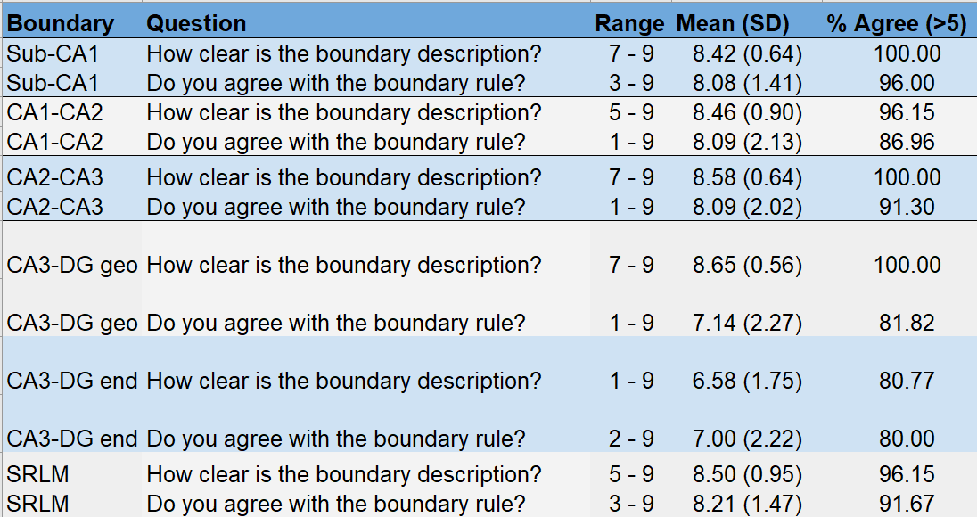
Step 4: Delphi Procedure for Consensus
Courtesy of
Dr. Valerie Carr
Body Inner Boundaries
N = 26 laboratories participated, all indicating previous experience with manual subfield segmentation
All inner boundary definitions had agreement and we queried opinions of description clarity
CA3-DG Definition Preference: 57.7% Geometric; 23.1% Endfolial; 19.2% No Opinion
Notes:
CA3-DG geo was a bit binary, with some people clearly opposed; nonetheless, the majority preferred the geometric rule about 2:1
CA3-DG end: 77%

Slide 25
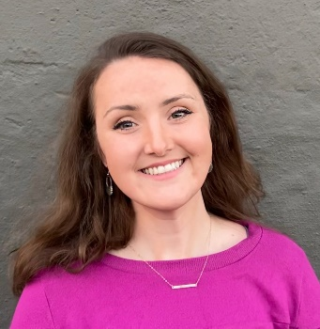
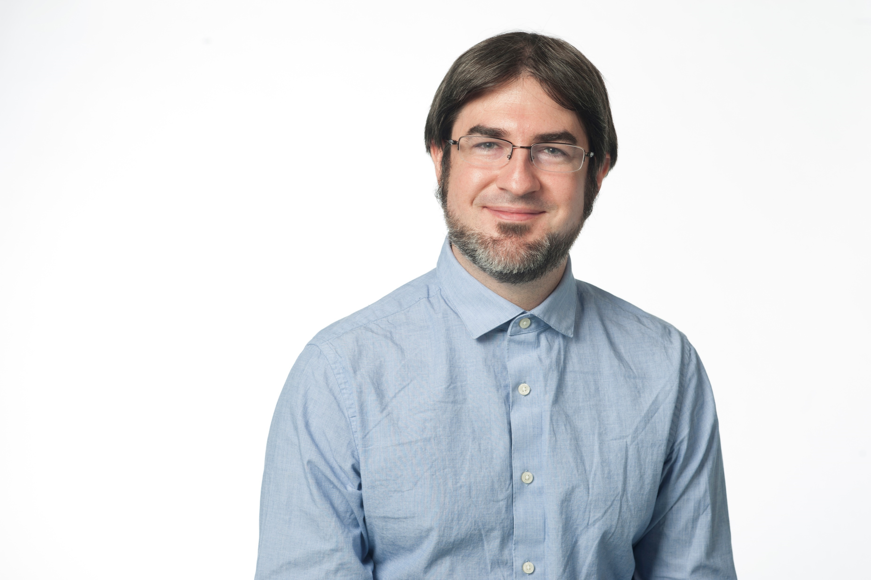

Step 5: Reliability
N = 24 brains sampled across lifespan, healthy and clinical presentations
2 expert raters, 1 novice rater; all naïve to protocol
Intra-Rater reliability after > 2 week delay
Dr. Kelsey Canada
Dr. Thackery Brown
Gustaf Rådman
 | Inter-Rater (3 raters, n = 24) |  |  | Intra-Rater (2 raters, n = 11)
Region | ICC(2,k) | Avg. DSC |  | Avg. ICC(2) | Avg. DSC
Sub, L | 0.87 | 0.86 |  | 0.87 | 0.90
Sub, R | 0.87 | 0.84 |  | 0.93 | 0.89
CA1, L | 0.88 | 0.84 |  | 0.84 | 0.88
CA1, R | 0.94 | 0.83 |  | 0.88 | 0.88
CA2, L | 0.66 | 0.61 |  | 0.89 | 0.73
CA2, R | 0.76 | 0.62 |  | 0.90 | 0.69
CA3, L | 0.91 | 0.70 |  | 0.96 | 0.80
CA3, R | 0.90 | 0.71 |  | 0.96 | 0.76
DG, L | 0.86 | 0.82 |  | 0.86 | 0.87
DG, R | 0.91 | 0.80 |  | 0.93 | 0.86

Slide 26
How to Cite the Protocol
Daugherty, AM, Amunts, K, Ekstrom A, Augustinack, J, Bakker, A, Berron, D, Brown, T, Burggren, A, Canada, KL, Carr, V, Chakravarty, M, Chetelat, G, de Flores, R, Ding, S-L, Geerlings, M, Kerchner, G, Insausti, R, Kedo, O, LaRocque K, Malykhin, N, Yassa, M, Mueller, S, Palombo, D, Radman G, Raz, N, Saifullah, S, Smith, C, Stark, C, Wang, L, Yu, Q, Yushkevich, P, La Joie, R*, Wisse, L*, Olsen, R*. A Harmonized Protocol for Hippocampal Subfield Segmentation on High-Resolution MRI: Consensus and Reliability for the Hippocampal Body. In preparation. * equal contribution senior authors
Published citation will be updated on the website and emailed to all workshop attendees.

Slide 27
Protocol Introduction
Review Terminology

Slide 28
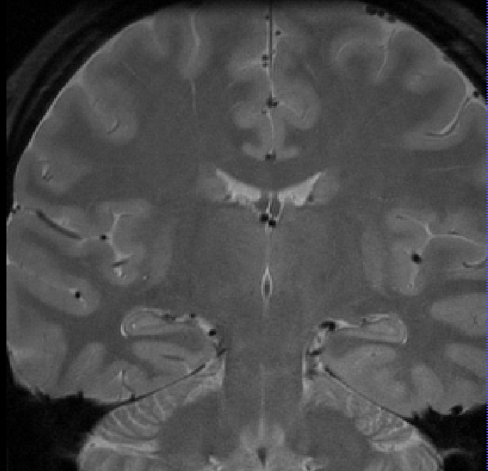
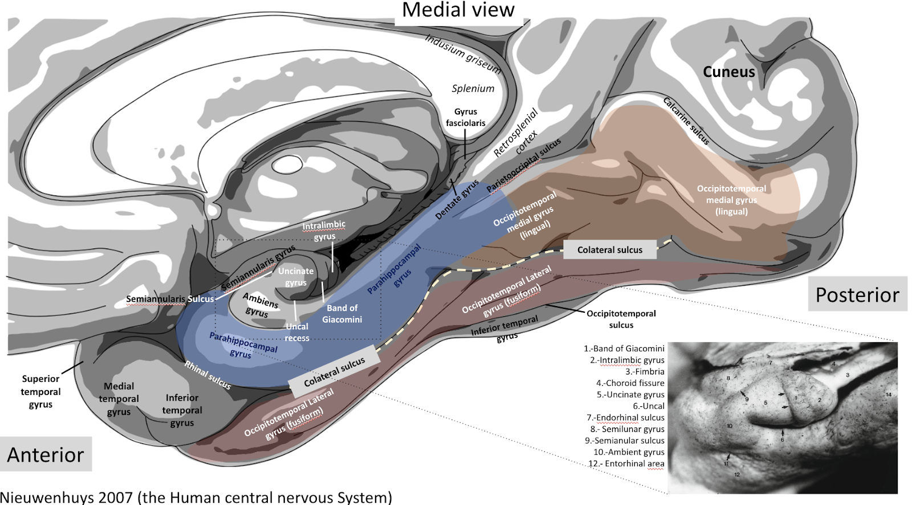
Directional Terms
Dorsal
(Superior)
Lateral
Medial
Ventral
(Inferior)

Slide 29
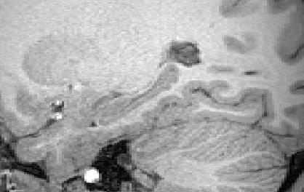
Macrostructure Terms
Posterior
Tail
Body
Anterior
Head
Long Axis
Example T1-weighted image

Slide 30
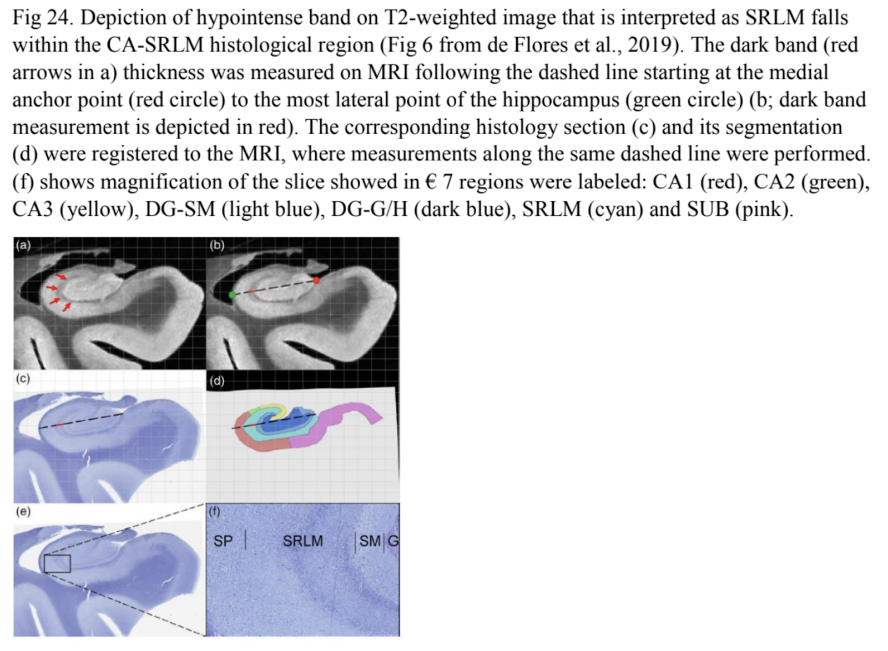
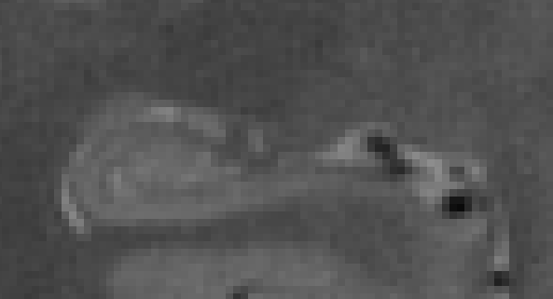
SRLM – Dark Band

Slide 31
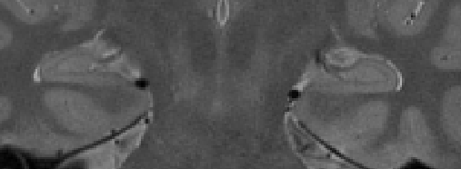
Partial Voluming
Introduces an element of subjectivity to rater decisions
  Reliability is consistent judgment
Definition: imaging artifact when signal from more than one tissue type is within a voxel
Common partial volume decisions:
  Tissue with CSF: to include or exclude?
  Gray matter with white matter: where does the boundary go?

Slide 32
Review Anterior-Posterior Body Ranging Protocol
First Step in the Outer Boundary Protocol

Slide 33
Purpose of Anterior-Posterior Ranging
Hippocampus body is the largest portion of the hippocampal length
Consistent morphometry <> Most agreement in anatomy
The anterior and posterior range isolates body slices for their morphometric similarity; other protocols are planned for head (anterior to body) and tail (posterior to body)
Ranging is meant to exclude slices that do not “look like body” so to avoid applying the body protocol to an inappropriate anatomical slice

Slide 34
Get Ready
Load Scan 1640
Select the Coronal View only: Click the C button
Auto-adjust contrast: Tools > Image Contrast > Auto-adjust (Ctrl+J)
Magnify 4x

Slide 35
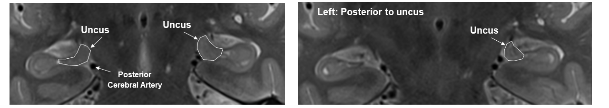
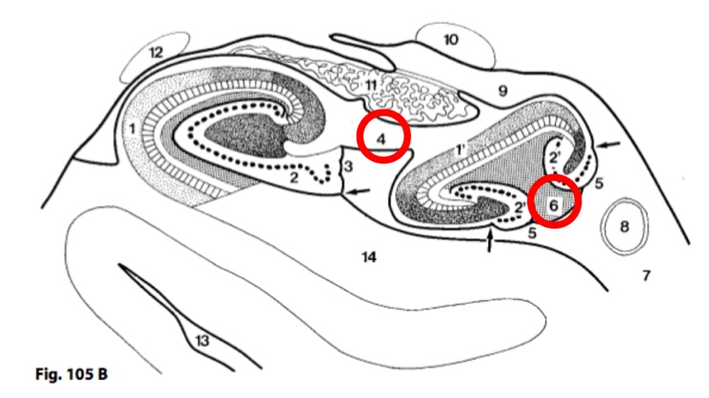
Anterior Boundary of Body
The anterior boundary of the hippocampal body (HB), i.e., the anterior-most slice included in the HB, is the first slice posterior to the last visualization of the uncus.
FIG 1. Top left: Hippocampal head displaying the uncus in both hemispheres. Top right: Slice showing the disappearance of the uncus in the left hemisphere, and as such, the anterior-most slice of the hippocampal body in the left hemisphere. T2-weighted image, resolution 0.39 x 0.39 x 2mm. Bottom: Sketch adapted from Duvernoy et al., 2013 with portions of the uncus labeled as 4 and 6

Slide 36
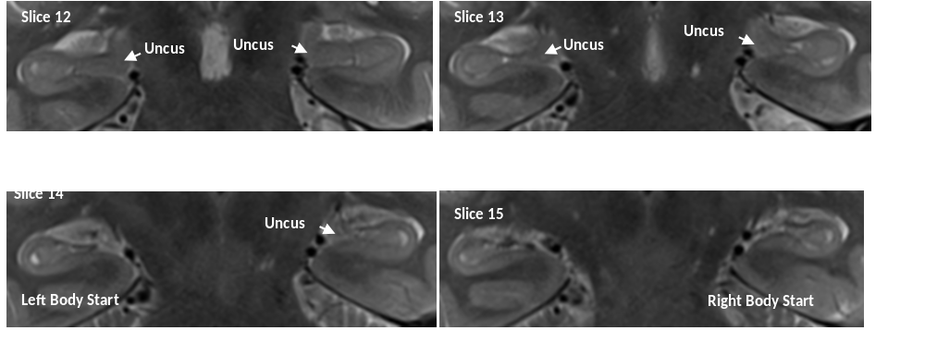
Anterior Boundary of Body
Can differ by hemisphere (typically within 1-2, 2mm slices)

Slide 37
Posterior Boundary of Body
The posterior boundary of the HB, i.e., the posterior-most slice included in the HB, is determined by a single landmark: the posterior-most slice on which the colliculi are visible. Can differ by hemisphere (occurs less often than the anterior boundary).

Slide 38
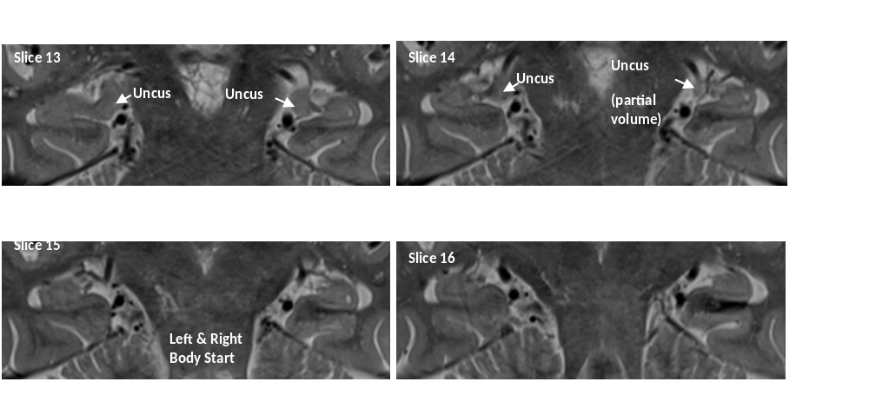
Special Consideration of Partial Voluming
If the uncus or collicuili are partial volumed, have to make a judgment if it is “present enough” to count

Slide 39
Special Consideration of Partial Voluming

Slide 40
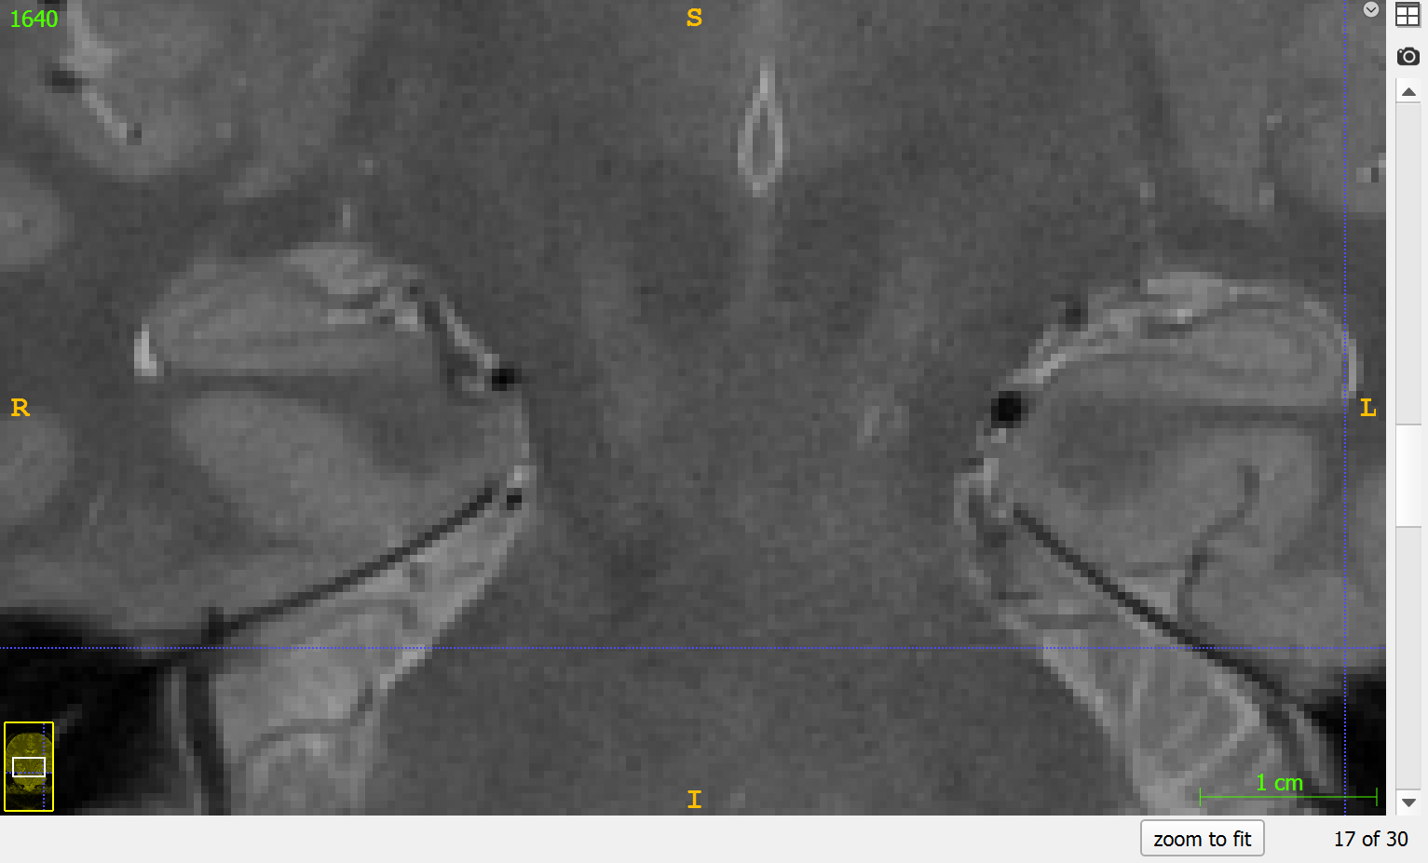
Demonstration

Slide 41
Now You Practice
Load example MRI and practice the ranging decisions
Note the slice numbers for the anterior and posterior slices
  Compare your decisions to the provided ranges
  Note what landmarks and visualizations on the images that you are using to make the decision -- this can expedite your training
Raise your hand if you have questions or would like to double check your thinking

Slide 42
Harmonized Protocol
for Subfield Segmentation in Hippocampal Body

Slide 43
Part 1: Geometric Heuristic for Inner Boundaries
for Subfield Segmentation in Hippocampal Body

Slide 44
Get Ready
Load up Scan 1640
Select the Coronal View only: Click the C button
Auto-adjust contrast: Tools > Image Contrast > Auto-adjust (Ctrl+J)
Magnify 4x

Slide 45
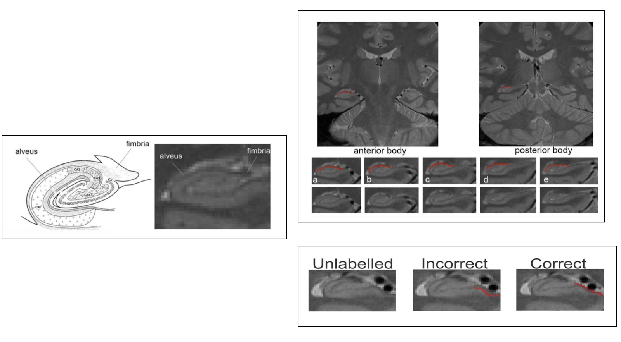
Review Relevant Anatomical Landmark
Alveus is included in the decision for the line 1 placement of “most lateral point”

Slide 46
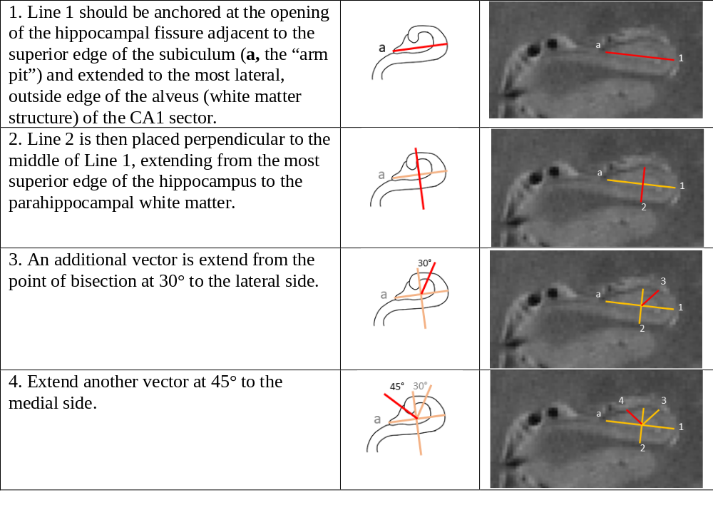
Review Steps in the Heuristic

Slide 47
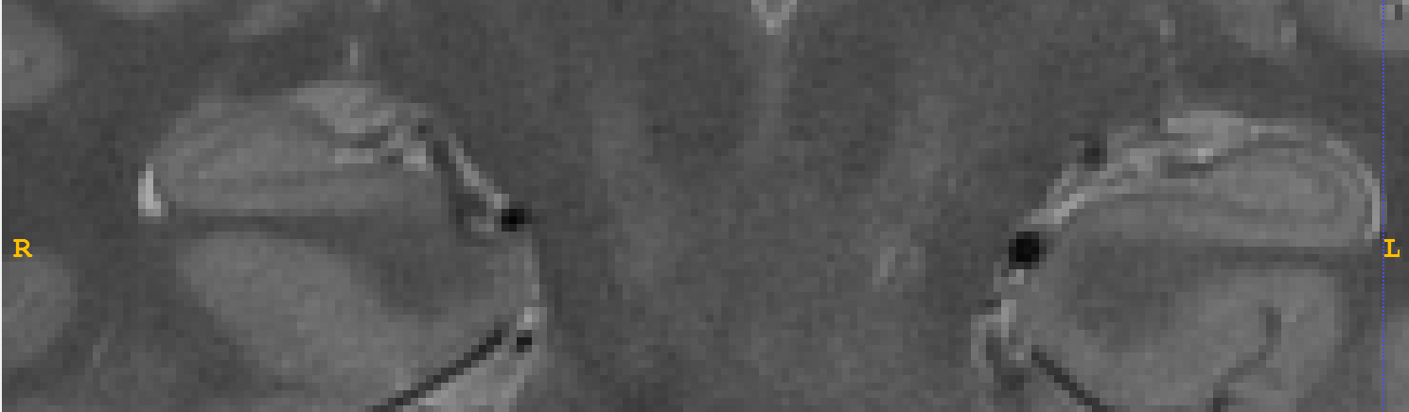
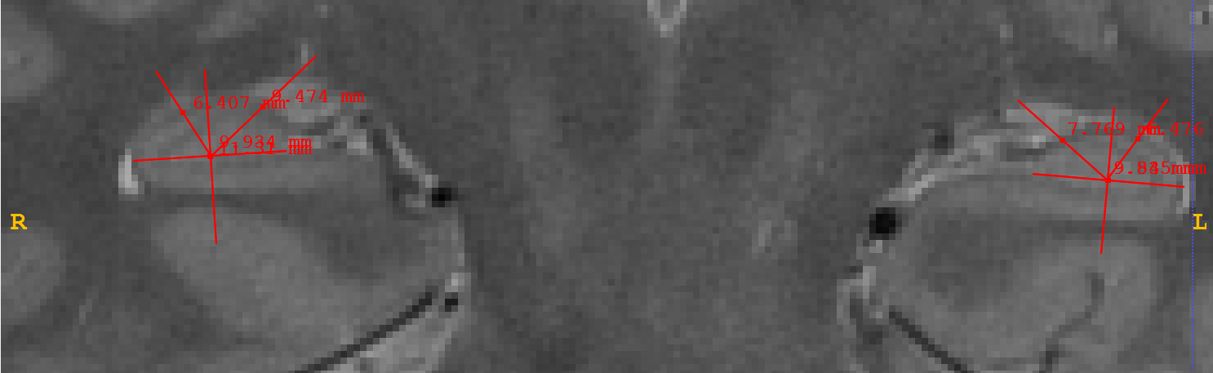
Demonstration

Slide 48
Now You Practice
Practice applying the geometric heuristic to 1640
  Raise your hand when you’re done and we will double check
  You can save your annotation file
Continue practicing with any of the other example scans
  Note what landmarks you are using in your decision for each slice, and where this is any ambiguity in the decision -- this can expedite your training
Raise your hand if you have questions or would like to double check your thinking

Slide 49
Part 2: Outer + Inner Boundaries for Segmentation
for Subfield Segmentation in Hippocampal Body

Slide 50
Get Ready
Load Scan 1640
Select the Coronal View only: Click the C button
Auto-adjust contrast: Tools > Image Contrast > Auto-adjust (Ctrl+J)
Magnify 4x
Load Segmentation Label Text File

Slide 51
General Notes
Label each subfield within a hemisphere on a given slice before labeling the other hemisphere. Refer to contiguous slices when making decisions about boundary placement to be generally consistent across slices moving anterior to posterior.
The SRLM defines the internal boundary of the CA1 and CA2 subfields. The subiculum, CA1 and CA2 subfields are drawn to include the SRLM, and to exclude it from the dentate gyrus.
Cysts or hippocampal sulcal cavities should not be labeled and are excluded from the subfield labels.
White matter is visualized as hypointense on a T2-weighted image.

Slide 52
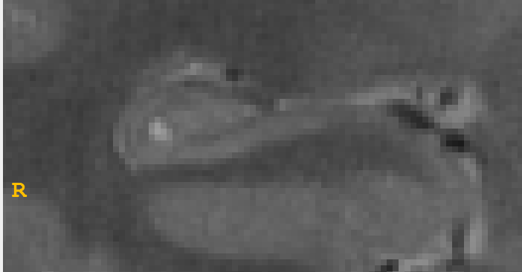
Outer Boundaries
The subfield labels are drawn to exclude:
  Ventral (inferior) parahippocampal white matter
  Alveus and fimbria
  CSF external in the ventricle
  Sulcal cavities
The subfield labels are drawn to include:
  Gray matter
  SRLM in the subiculum and CA fields
Example images with sulcal cavities

Slide 53
White Matter Structures
Alveus & Fimbria are excluded
SRLM is included in CA fields and subiculum

Slide 54
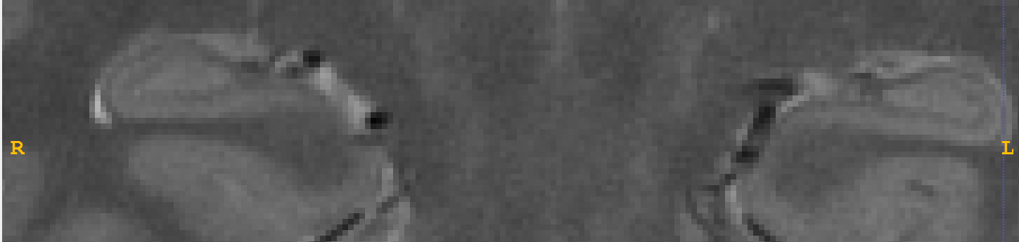
Subiculum Medial Boundary
Anterior Body: The medial subiculum-cortex boundary is defined as a horizontal line extending from the most medial superior aspect of the parahippocampal white matter to the CSF.

Slide 55
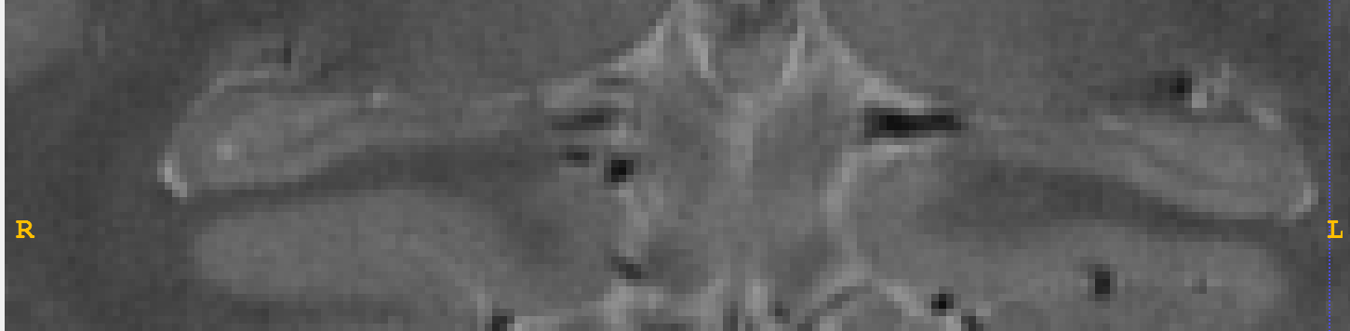
Subiculum Medial Boundary
Posterior Body: The subiculum-cortex boundary is defined as the superior medial point—it extends to the medial edge of the hippocampus where it meets the parahippocampal gyrus; visualized as the medial portion of the subiculum tapering and terminating at the beginning of the calcarine sulcus, appearing as a “notch”.

Slide 56
Checking Your Segmentations
Refer to contiguous slices before/after to help make decisions
After editing the labeled masks, double check the heuristic again
  The Sub-CA1 boundary should line up with the CA2-CA3 boundary
After segmenting all slices, move through anterior-posterior to check for continuity in labeled masks

Slide 57
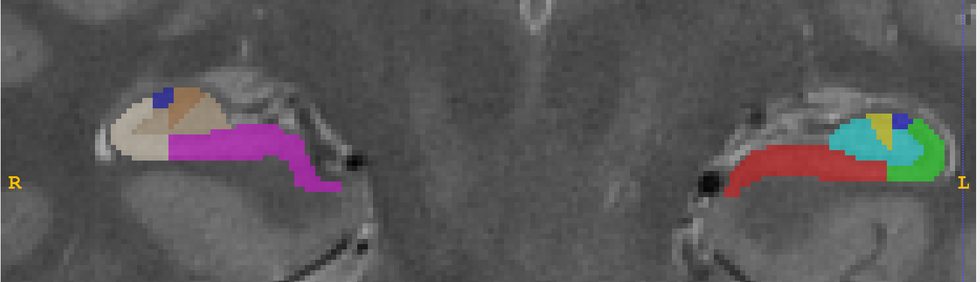
Demonstration

Slide 58
Now You Practice
Load any of the example images and practice the ranging decisions
Note the slice numbers for the anterior and posterior slices
  Compare your decisions to the provided ranges
  Note what landmarks and visualizations on the images that you are using to make the decision -- this can expedite your training
Raise your hand if you have questions or would like to double check your thinking

Slide 59
Advice for Reliability Testing
Why is it important? How to make it feasible for your lab.

Slide 60
Considerations to Assess Validity
Reliability is necessary but not sufficient for validity
Compare segmentations to “ground truth” to assess construct validity
For manual methods this is typically established with high reliability and an assessment of face validity compared to reference histology
For automated methods starts with a reliable training set, then:
  Gold Standard: Auto Labels on Ex vivo Scan to Histological labels
  Bronze Standard: Auto Labels on In vivo Scan to Reliable Manual Segmentation
  Validation in hold-out sample and Cross-Validation with new sample

Slide 61

Ways to Assess Reliability
Choose the Test Statistic Based on Your Intention for Analysis
Kappa coefficient (k)
agreement in categorical decisions (e.g., slice ranging)
Intra-class correlation coefficient (ICC)
continuous measures (e.g., volume)
Dice coefficient (DSC)
spatial overlap (e.g., masks)

Slide 62

Reliability: How Much Error to Tolerate?
Total Measured Variance = True Population Variance + Measurement Error
True Variance
Total Variance
Reliability =
Proportion of error = 1 - R
In general:
R =1 (100% true; 0% error)
R = 0 (0% true; 100% error)
How much error can we handle in the measure?
ICC = 0.50 (50% error)
ICC = 0.60 (40% error)
ICC = 0.75 (35% error)
ICC = 0.85 (15% error)
ICC = 0.90 (10% error)
“acceptable”
“good”
“excellent”

Slide 63

Using this Information for Study Planning
Dr. Roya Homayouni
Reliability is rater- and sample-specific
Choosing a protocol that includes labels of interest
  To combine or not to combine subfields?
  The tradeoff of sensitivity and specificity.
Reliability of measurement directly goes to sensitivity and statistical power
N ~ 160
N ~ 80
Houmayouni et al., 2021 J Neurosci Res

Slide 64
Making a Reliability Set in Your Lab
Common reliability set in your lab – everyone is reliable with one another
  Can have multiple reliability sets for different pairs of raters if needed
  Add new raters over time
Include scans with representative variability of your sample
  Age range
  Sex, Race/Ethnicity
  Different time points?
  Different magnets or parameters
Include scans of representative quality
  Not all the best scans, not all the worse scans
  If a scan is an outlier in a reliability set, you can remove it but be careful to note why there may have been high disagreement on that scan
N = 15-30 scans (it is possible to over-fit the reliability statistics)

Slide 65
Reliability Statistics Assume Independence
Inter-rater reliability: between different tracers
Intra-rater reliability: within the same tracer, repeated on the same scans (or same participants, multiple time points)
Assumed Independence means…
  Between raters – the different raters do not consult with each other during the test
  Within rater, same scans – a sufficient delay to reasonably assume they do not have explicit memory of the prior tracing (>2 weeks is common)
  Within rater, different time points – scans are labeled for the rater to blind to time point

Slide 66
Advice for Implementation
Setting it up in your lab

Slide 67
Tips for Hardware & Tracing Environment
The main test is reliability: if raters have their own preferences and are still reliable, then it’s okay
Some things to consider that can affect reliability:
  Tracing environment / room brightness
  Tracing Tablet or Mouse?
  Size of the screen
  Different practices in image contrast manipulation or zoom
Example Tracing Tablets: Huion and Wacom Cintiq

Slide 68
Tips for Organization
File organization
  Label scans and segmentation files with the same ID
  Include rater initials with segmentation file name, or in linked documentation
  Notes on tracing quality and ranging decisions
SOP and Rater Training
  Create a standardized training procedure for new team members
  Maintenance of skill – if a rater starts to drift, retrain to reliability
  Record reliability in a common location to use in papers and grants

Slide 69
Tips for Data Collection Procedures
Rater reliability is established before tracing data begins
Assign raters to scans for tracing at random
  Raters are highly consistent with one another, but not identical; randomize the small amount of rater error to avoid bias
Checking data
  Data screening: correlations between hemispheres, across time points; outliers
  Random subset checking after tracing is complete
  Assign 2 raters per case, randomly assigning slices to trace; 2nd rater refers to 1st rater for consistent decision making and can catch mistakes
Outer boundary anterior-posterior ranging
  Can be done separately before tracing; can be done by different people besides tracers

Slide 70
Tips for Rolling Enrollment and Longitudinal Designs
Data tracing can be done in batches; be mindful of randomized assignment across batches
  Start with the data you have and add batches every few months
  Check for rater drift with time during data screening; time of tracing (in a cross-sectional cohort) should not correlate with measurement if participants were enrolled randomly
Longitudinal waves can be traced separately but better if partially randomized
  Re-trace a random set of baseline scans with the longitudinal scans
  Confirm rater reliability is consistent for baseline scans
  Can trace longitudinal scans “side-by-side” if rater is blind to time point

Slide 71

Stay Tuned for More
Questions?
Subfield in Head and Tail Label, Medial Temporal Lobe Cortices
Automated atlas of the Harmonized Body Protocol (with updates for other regions)

